Slide 1
Section J
Carbohydrate metabolism
Guodong Yang
Biochemistry and Molecular Biology, College of Life Sciences
gdyang@sdau.edu.cn
13854808762

Slide 2
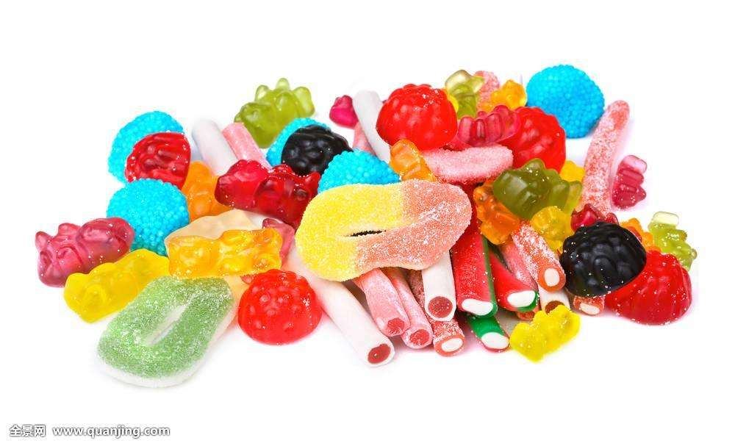
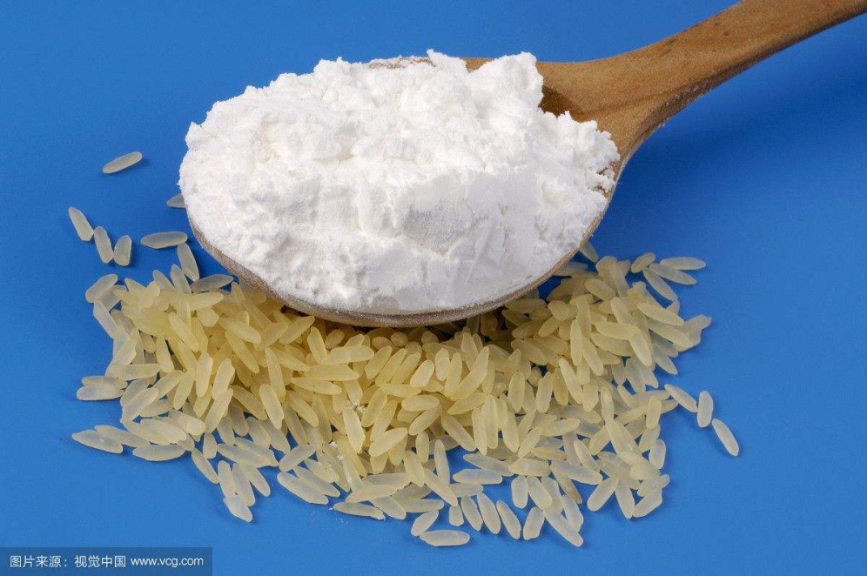
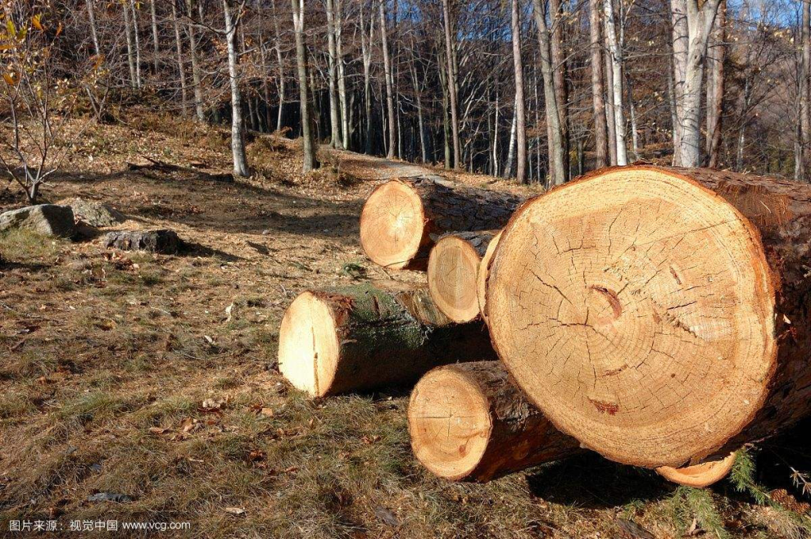
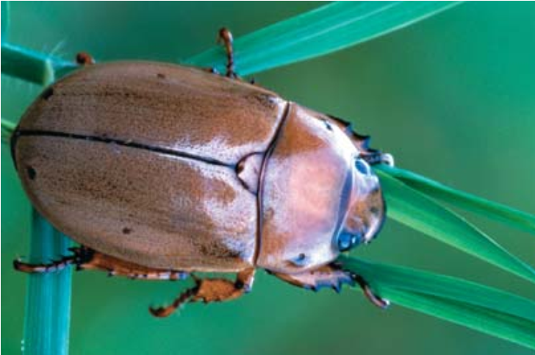
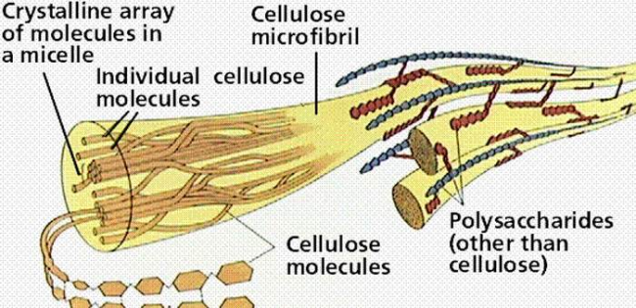
糖果
淀粉
纤维素
几丁质

Slide 3
J1 Monosaccharides and disaccharides
J2 Oligosaccharides and polysaccharides
J3 Glycolysis
(EMP: Embden-Meyerhof pathway)
L1 The Citric Acid Cycle
(TCA: tricarboxylic acid cycle)
J5 Pentose phosphate pathway
J4 Gluconeogenesis
J6 Metabolism of glycogen, starch and sucrose

Slide 4
J1 Monosaccharides
and disaccharides

Slide 5
Monosaccharide
Aldoses (醛糖） and ketoses（酮糖）
A monosaccharide has the general formula (CH₂O)_{n} and contains either an aldehyde group (an aldose) or a ketone group (a ketose).

Slide 6
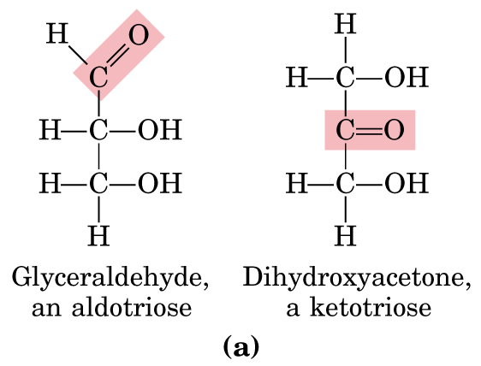

Slide 7
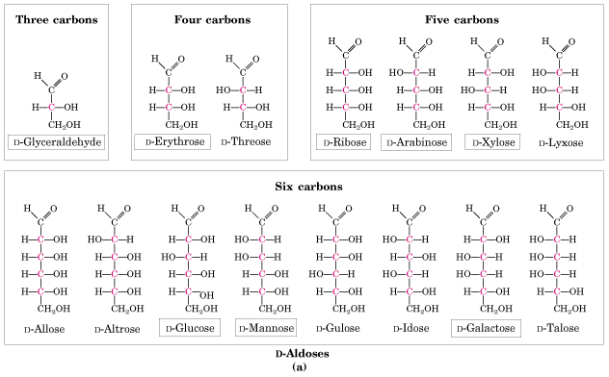
Aldoses
(赤藓糖）
阿拉伯糖 木糖
葡萄糖 甘露糖 半乳糖

Slide 8
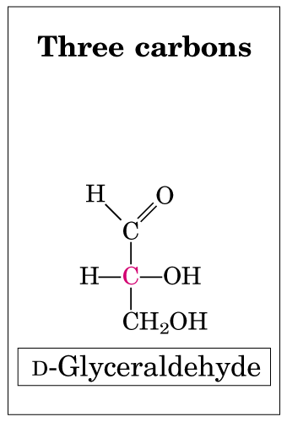
Notes:
8

Slide 9
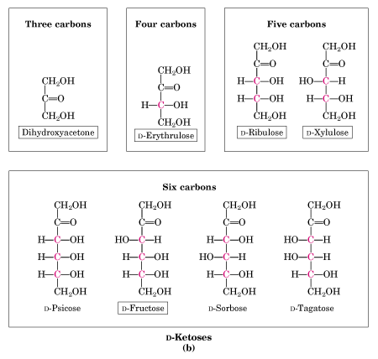
二羟丙酮
赤藓酮糖
核酮糖
木酮糖
果糖
Ketoses
Notes:
9

Slide 10
1.1.Stereoisomers
The D and L stereoisomers of sugars refer to the configuration of the asymmetric carbon atom furthest from the aldehyde or ketone group.

Slide 11
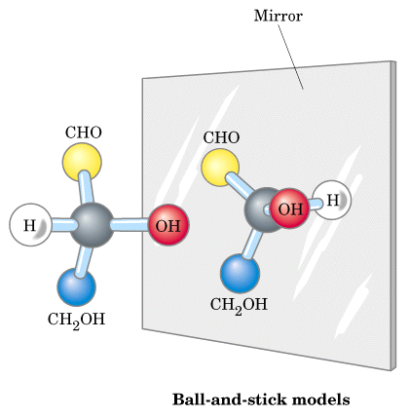

Slide 12
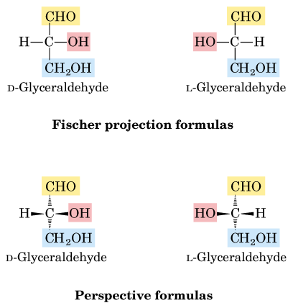

Slide 13
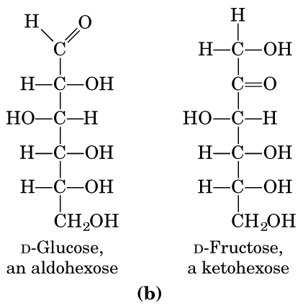

Slide 14
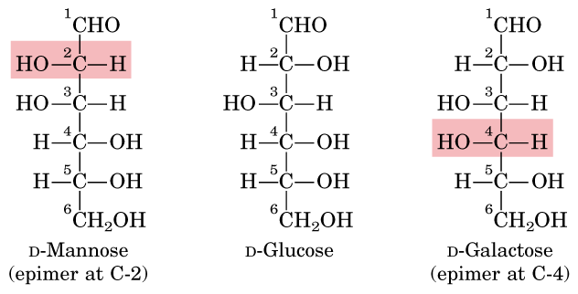
Two sugars that differ only in the configuration around one carbon atom are called epimer.
Notes:
14

Slide 15
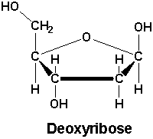
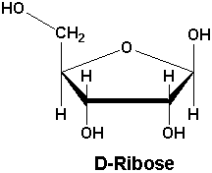
Deoxyribose and Ribose
D型
β型
Isomeric forms of monosaccharides that differ only in their configuration about the hemiacetal or hemiketal carbon atom are called anomers, and the carbonyl carbon atom is called the anomeric carbon.

Slide 16
1.2 Ring structure
Aldotetroses and larger sugars can cyclized by reaction of the aldehyde or ketone group with a hydroxyl group on another carbon atom of the sugar.

Slide 17
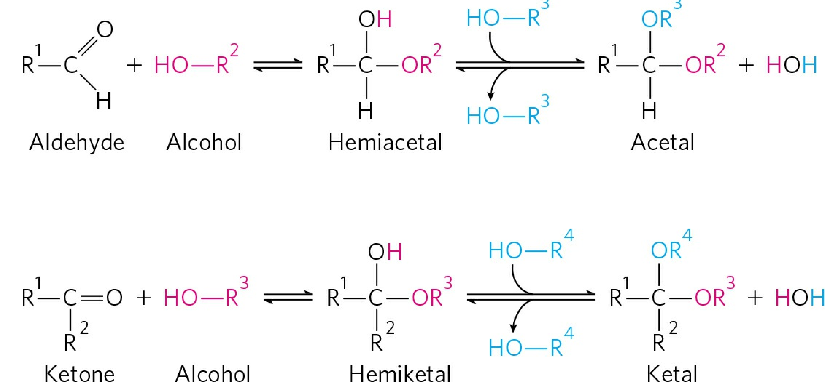
Formation of hemiacetals and hemiketals

Slide 18
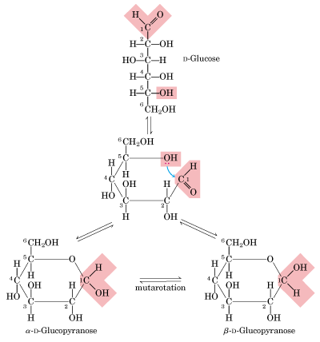
吡喃（型）
葡萄糖
hemiacetal
pyranose

Slide 19
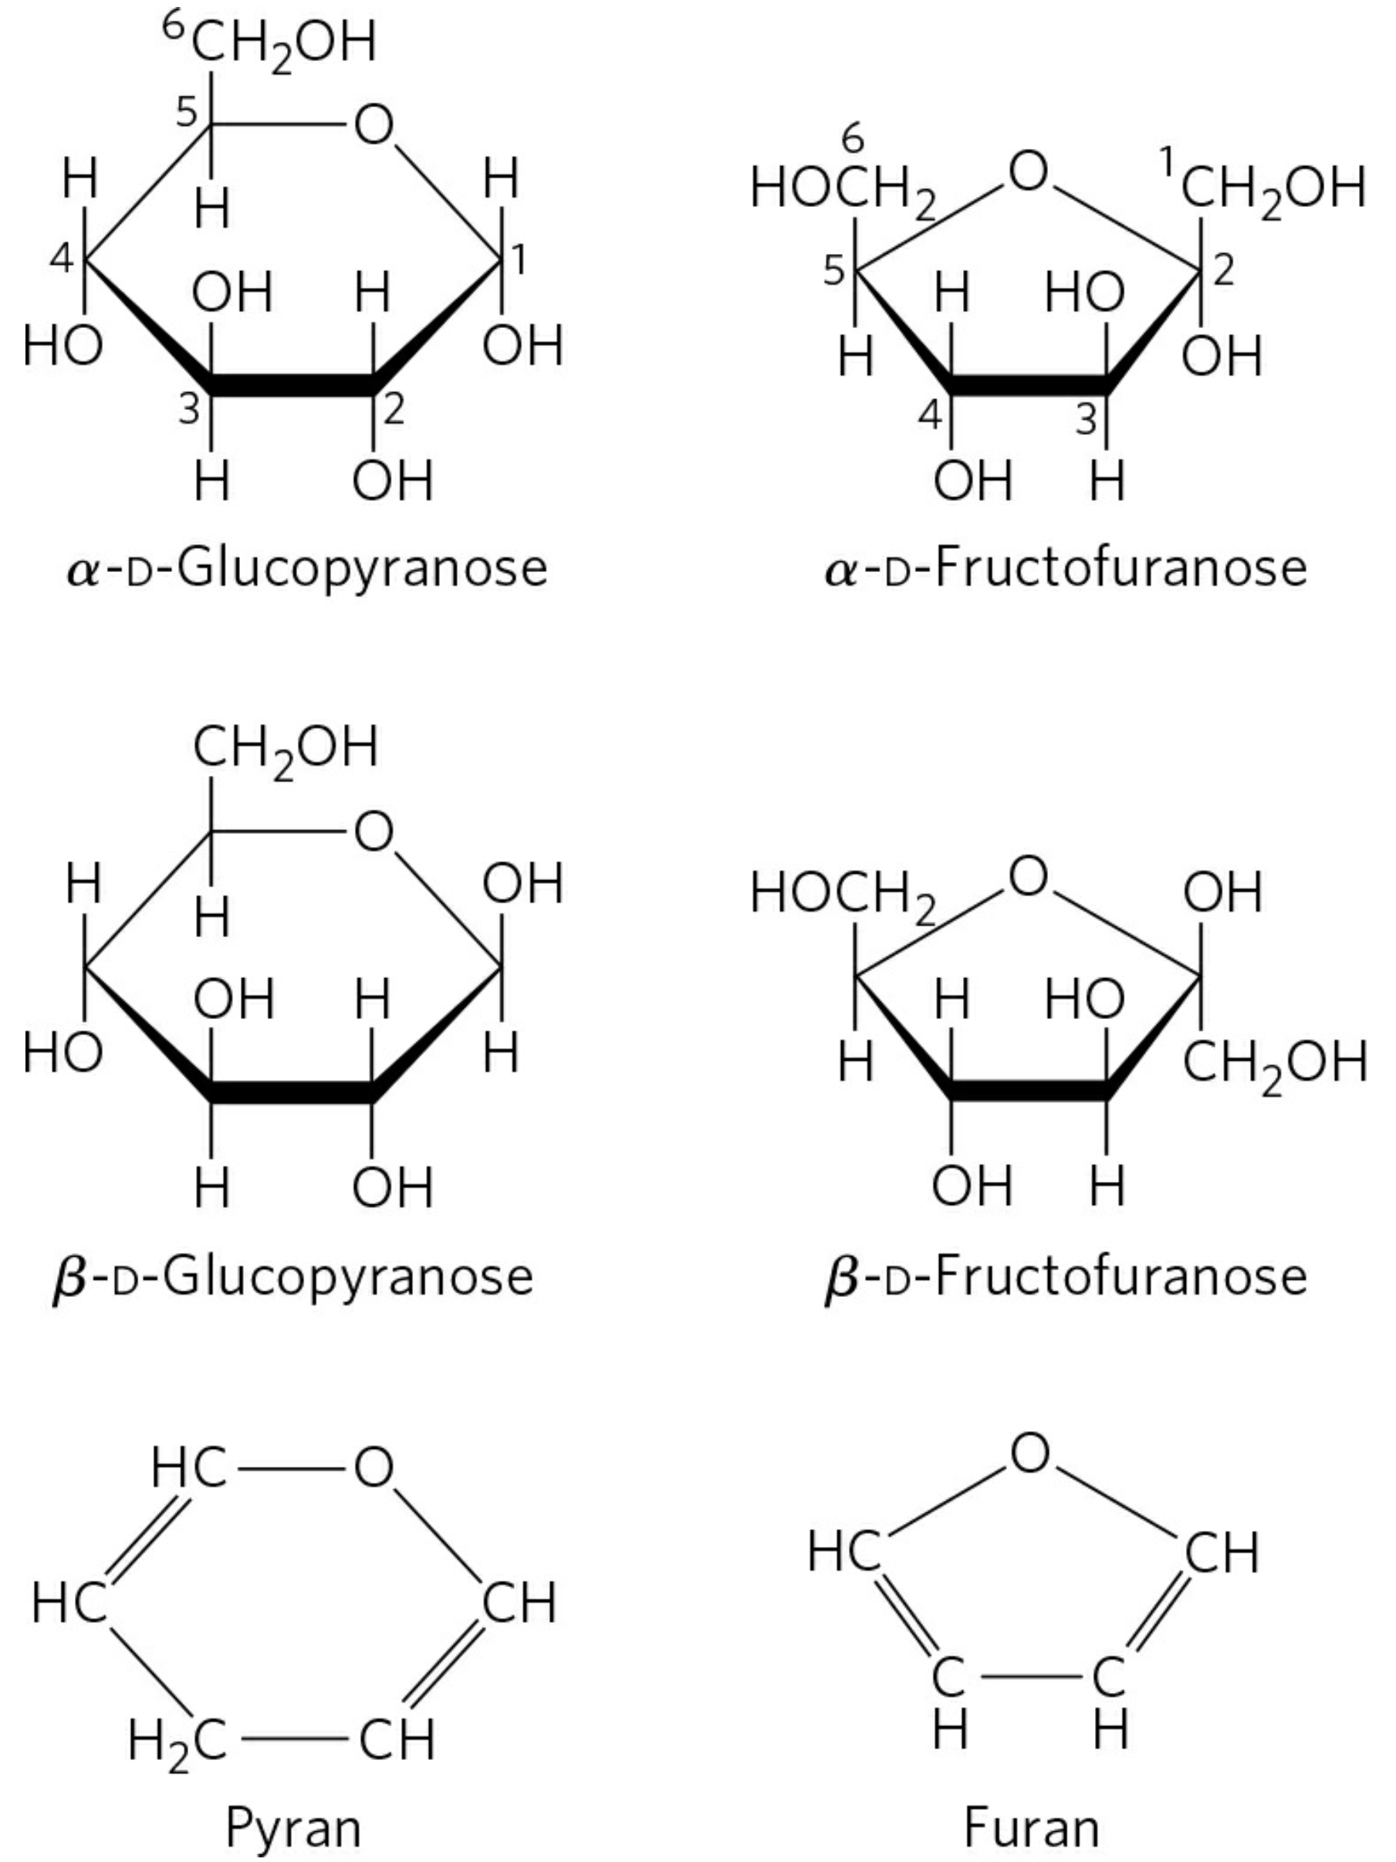
吡喃（型）
葡萄糖
呋喃（型）
果糖

Slide 20
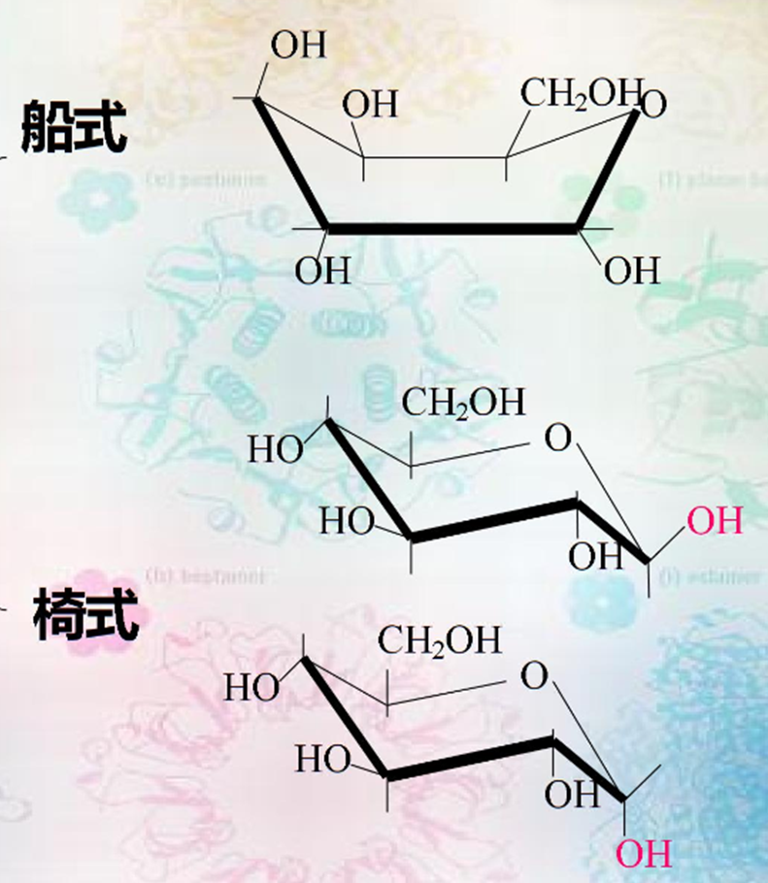
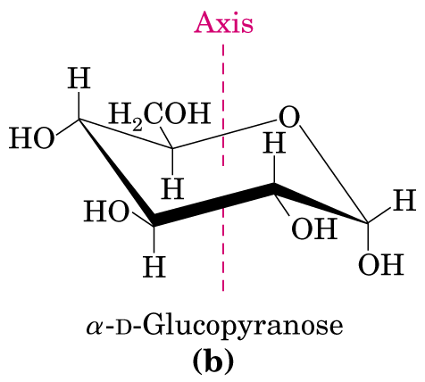
Chair form of the pyranose ring
船式不稳定，椅式稳定

Slide 21
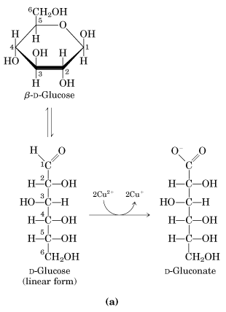
1.3 Reducing sugar
A monosaccharide is a reducing sugar.

Slide 22
2. disaccharides
A disaccharide is formed when two monosaccharides become joined by a glycosidic bond.

Slide 23
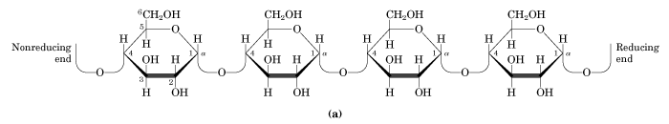
Nonreducing
end
Reducing
end
OH
OH
glycosidic bond
1↔1
1↔2
1→3
1→4
1→6
for glucose

Slide 24
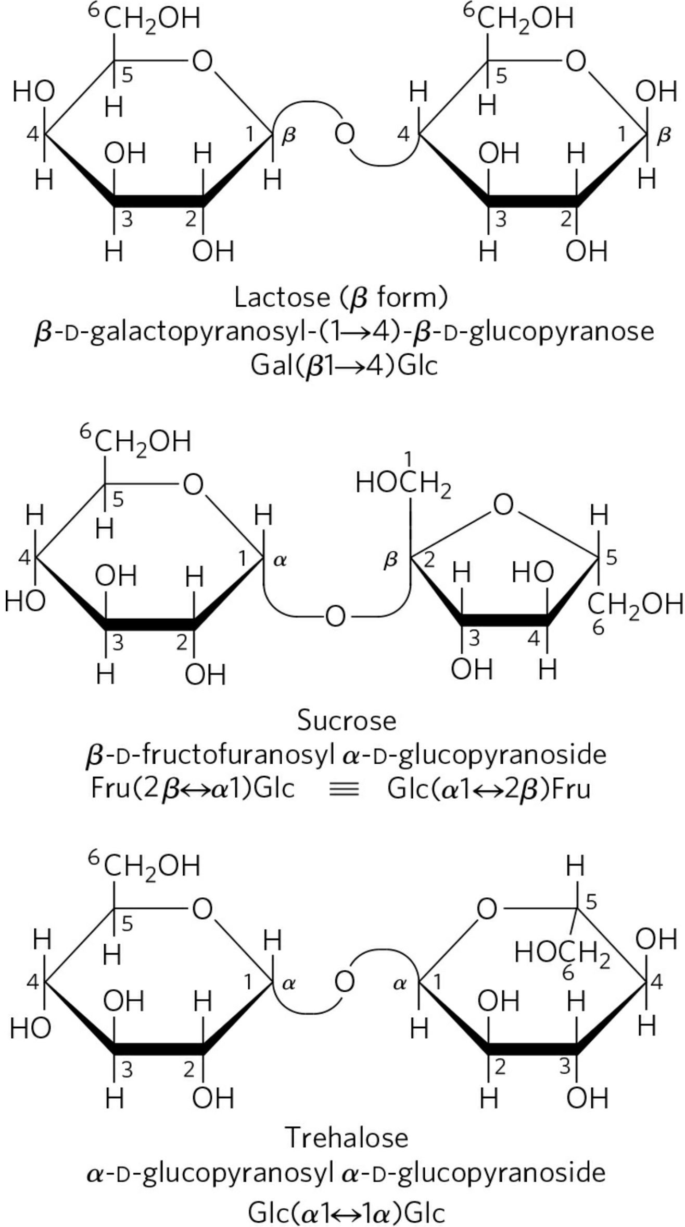
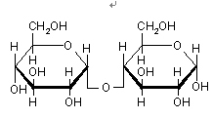
Maltose (α 1→4)

Slide 25
3. Sugar derivatives
The hydroxyl groups of sugars can be replaced by other groups to form a wide range of biologically important molecules including phosphorylated sugars, amino sugars and nucleotides.

Slide 26
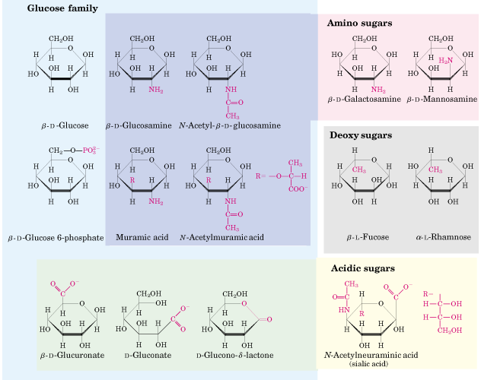

Slide 27
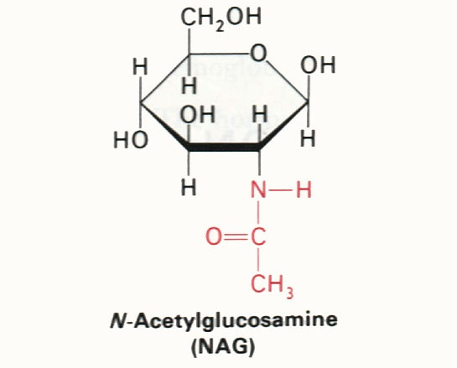
N—乙酰氨基葡萄糖 NAG

Slide 28
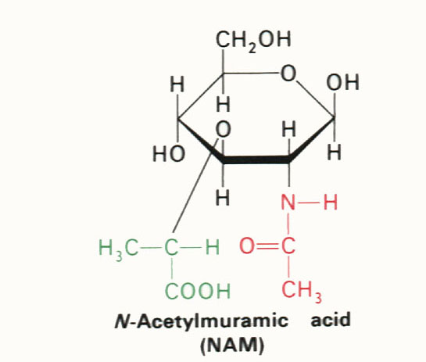
N—乙酰胞壁酸 NAM

Slide 29
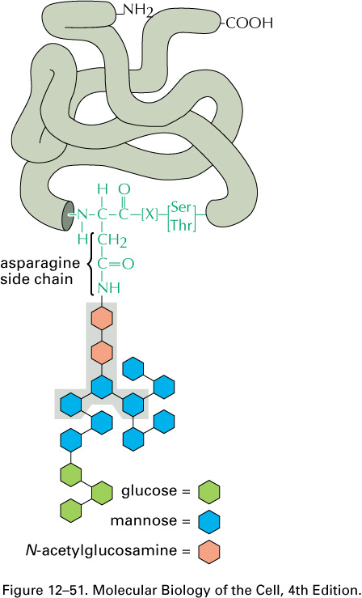
Recall: Proteins are Glycosylated in ER and Golgi
Asn-[X]-Ser/Thr
-important for folding
-important for function
-important for targeting
乙酰氨基葡萄糖

Slide 30
4. nomenclature
The names of simple sugars and sugar derivatives can all be abbreviated.
Glc glucose
Fru fructose

Slide 31
J2 Polysaccharides and
oligosaccharides
Long chains of monosacharides joined together are collectively called polysaccharides. The major storage polysaccharides are glycogen, starch。 and dextran. Cellulose is a structural polysaccharide found in plant cell wall.

Slide 32
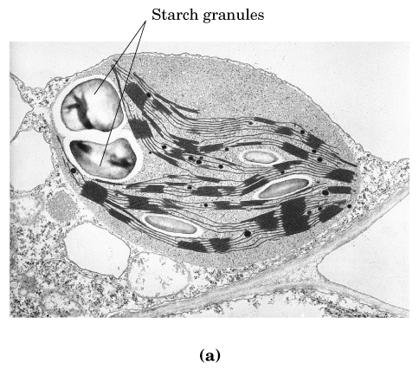

Slide 33
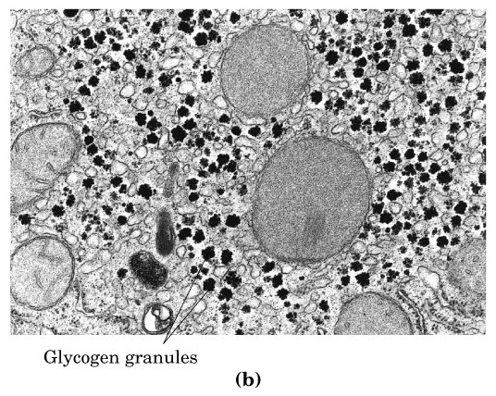

Slide 34
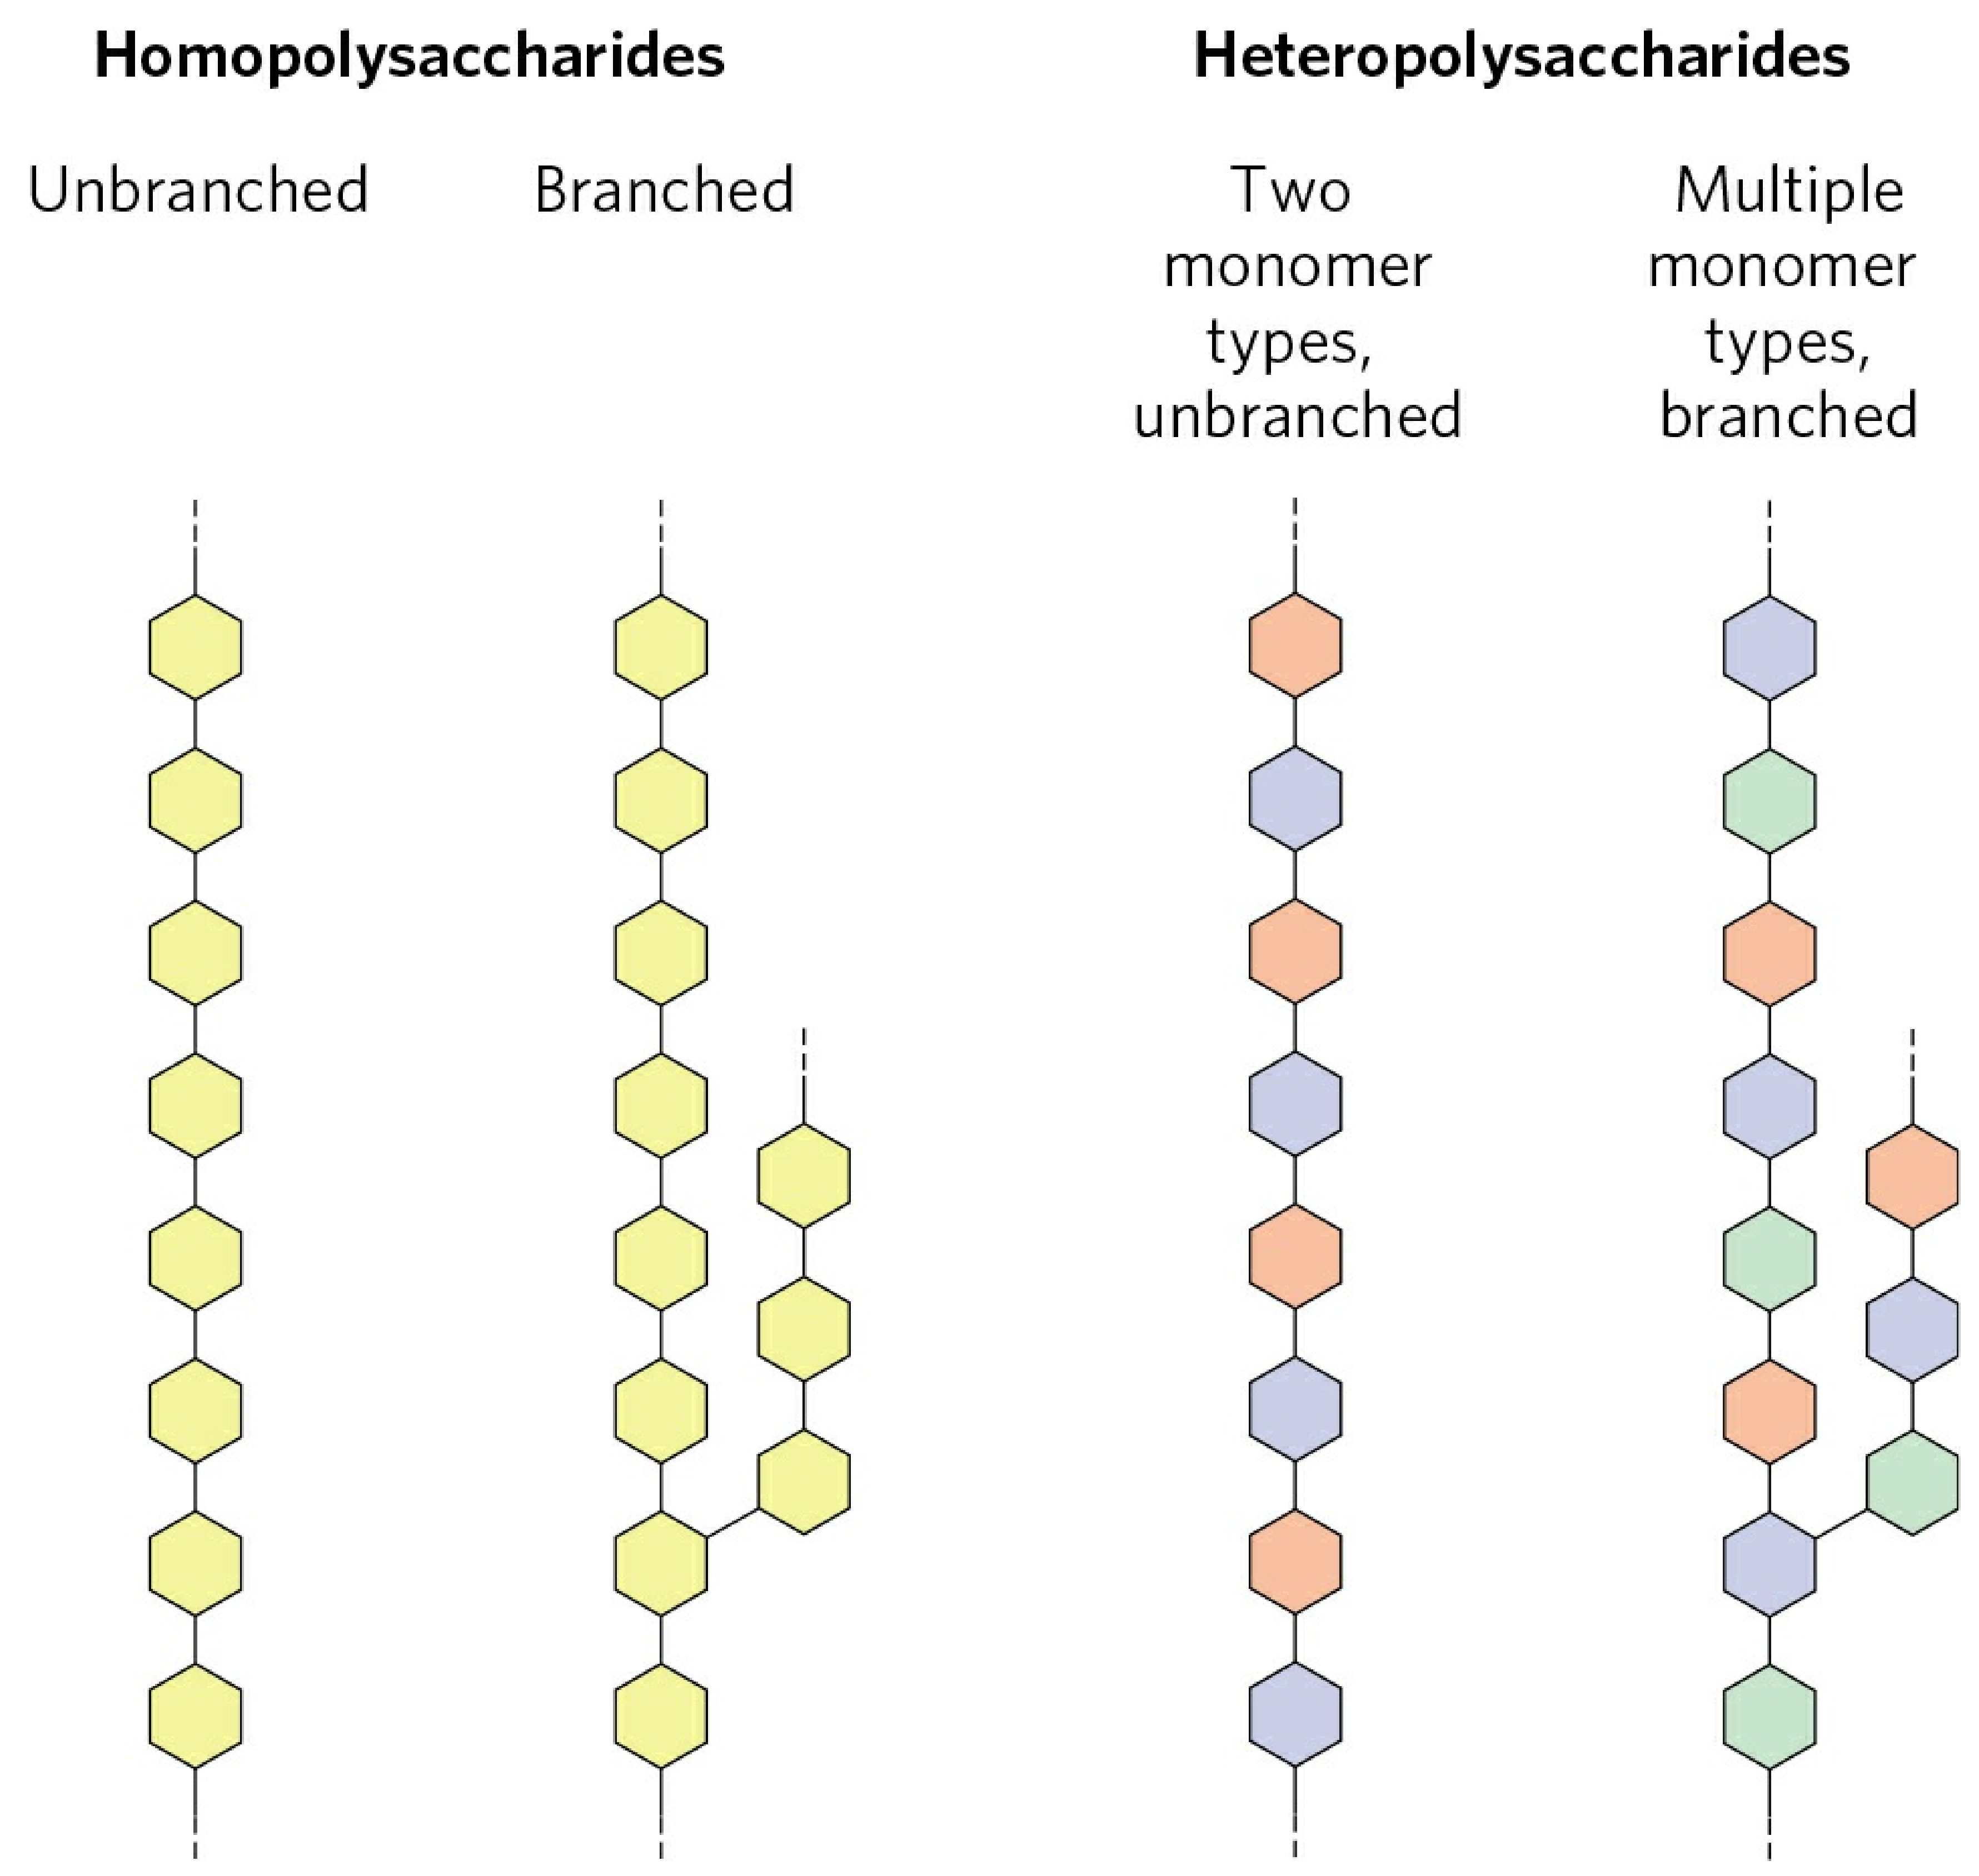

Slide 35
glycosidic bond

Slide 36
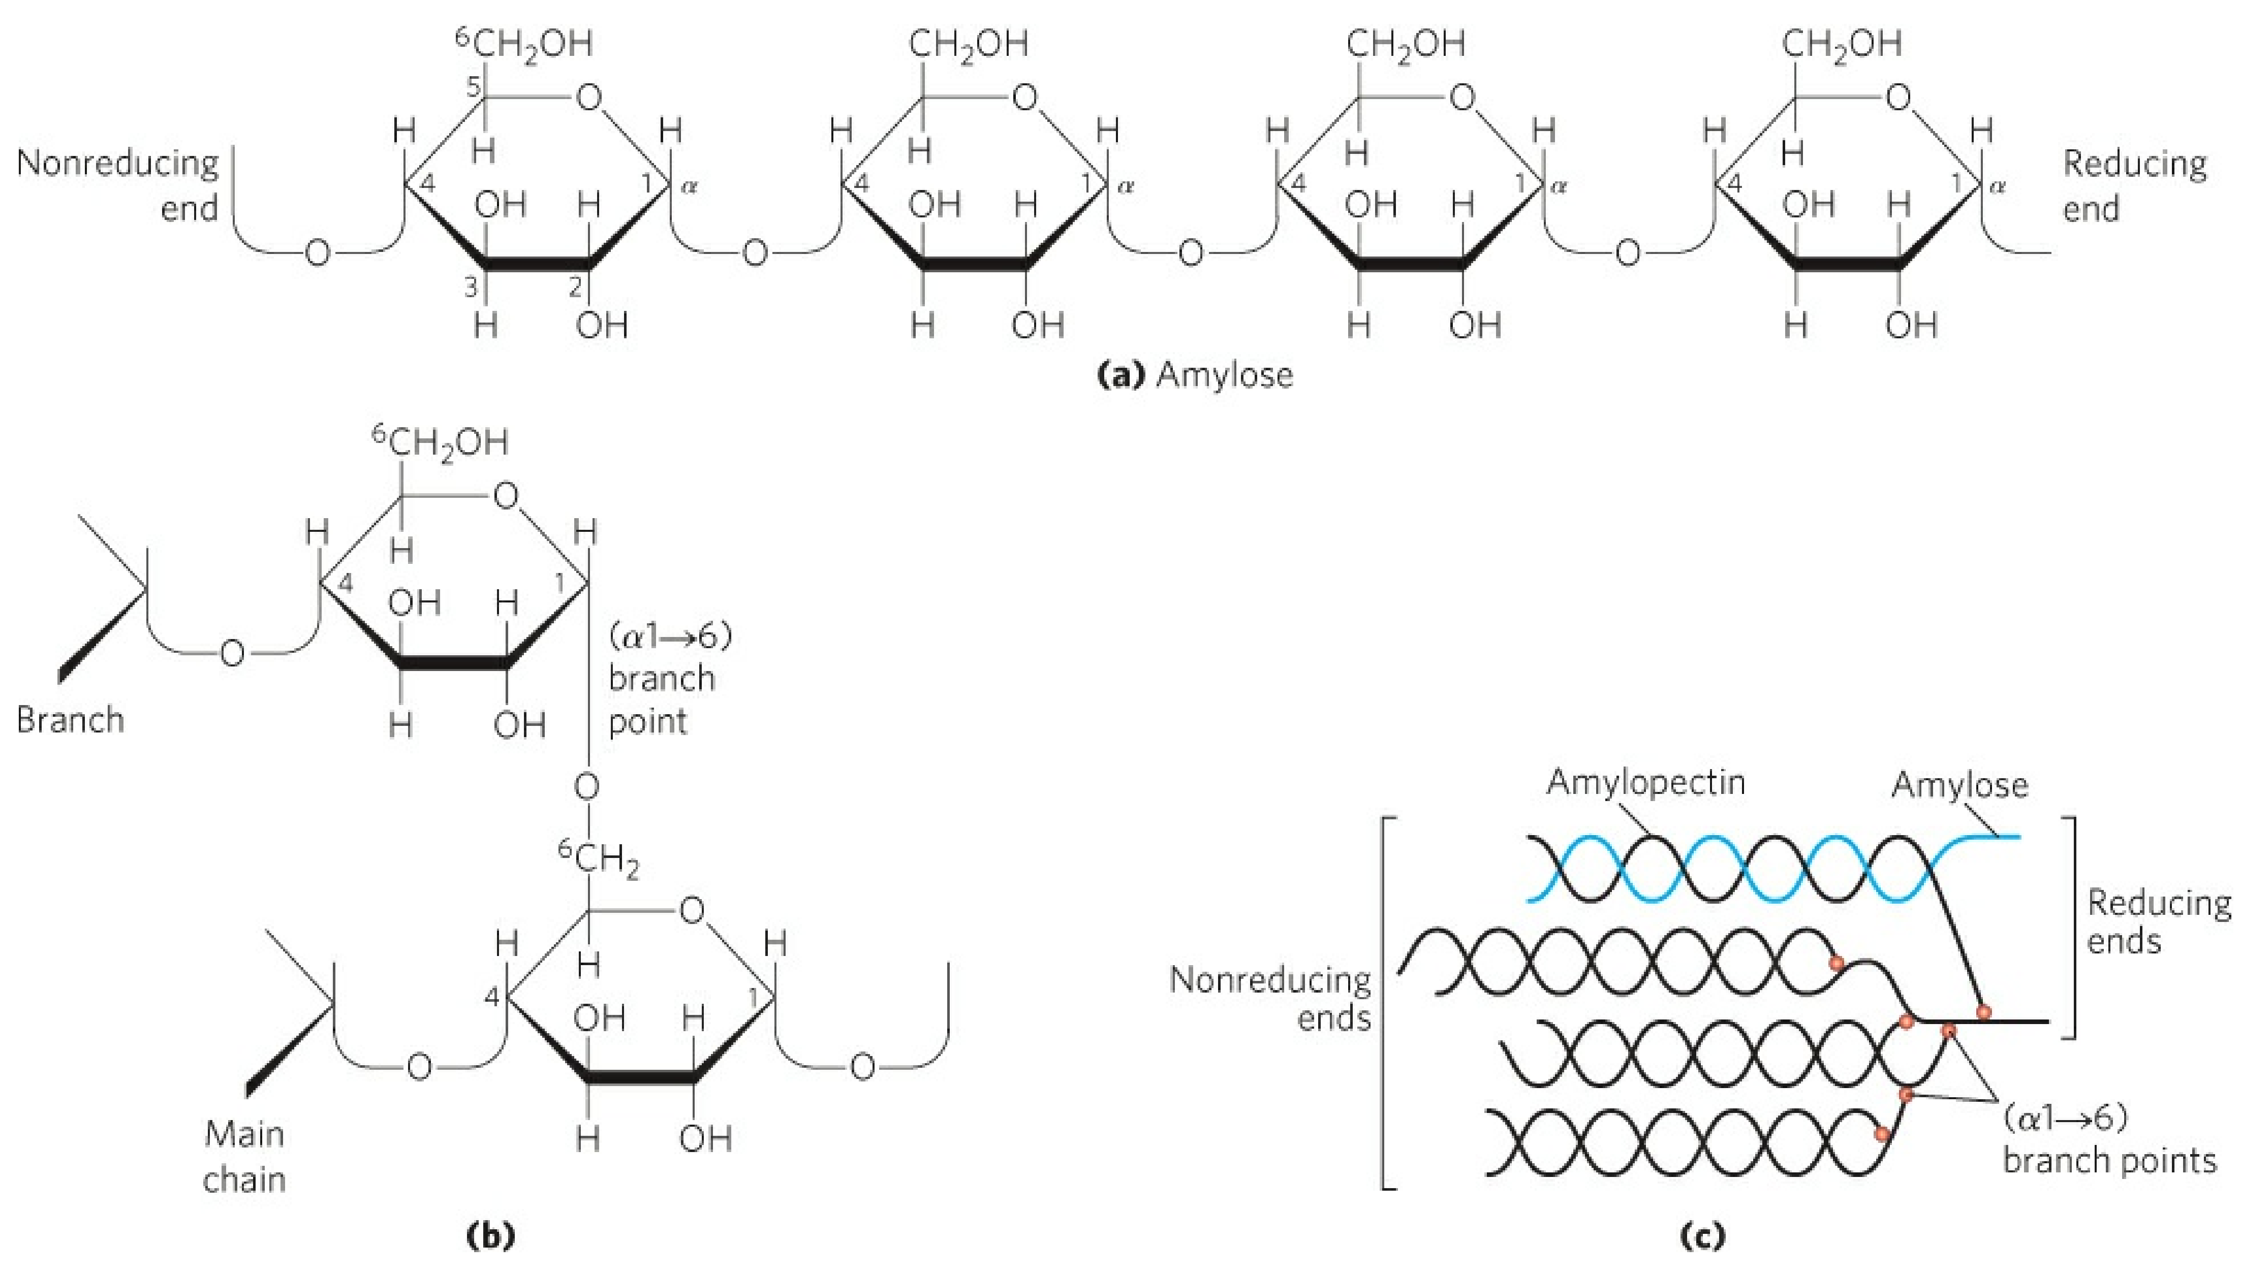
Starch: amylose, amylopectin in plants
glycogen in animals
α-D-glucose as monomer

Slide 37
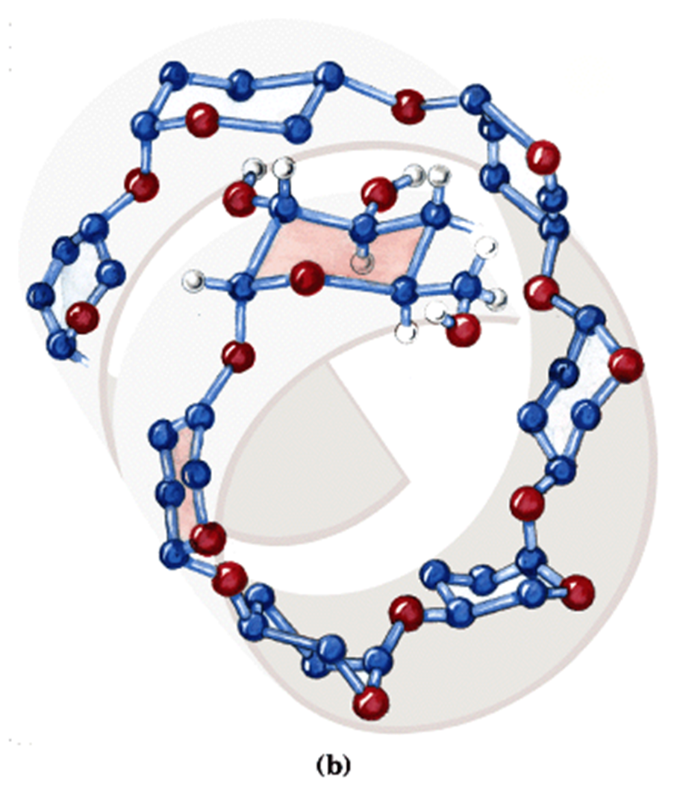
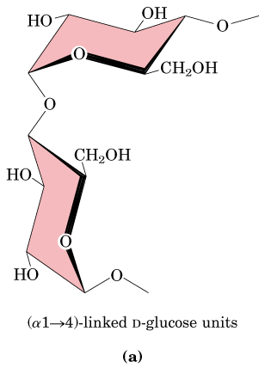
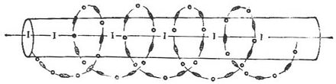
starch

Slide 38
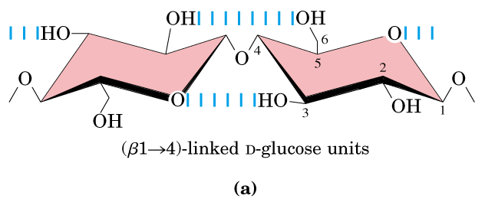
β-D-glucose as monomer

Slide 39
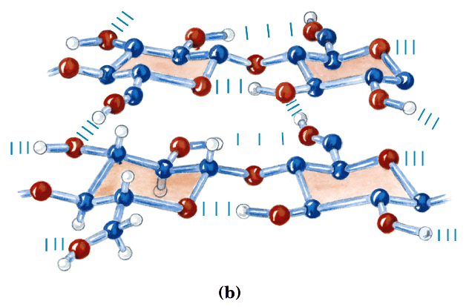
cellulose

Slide 40
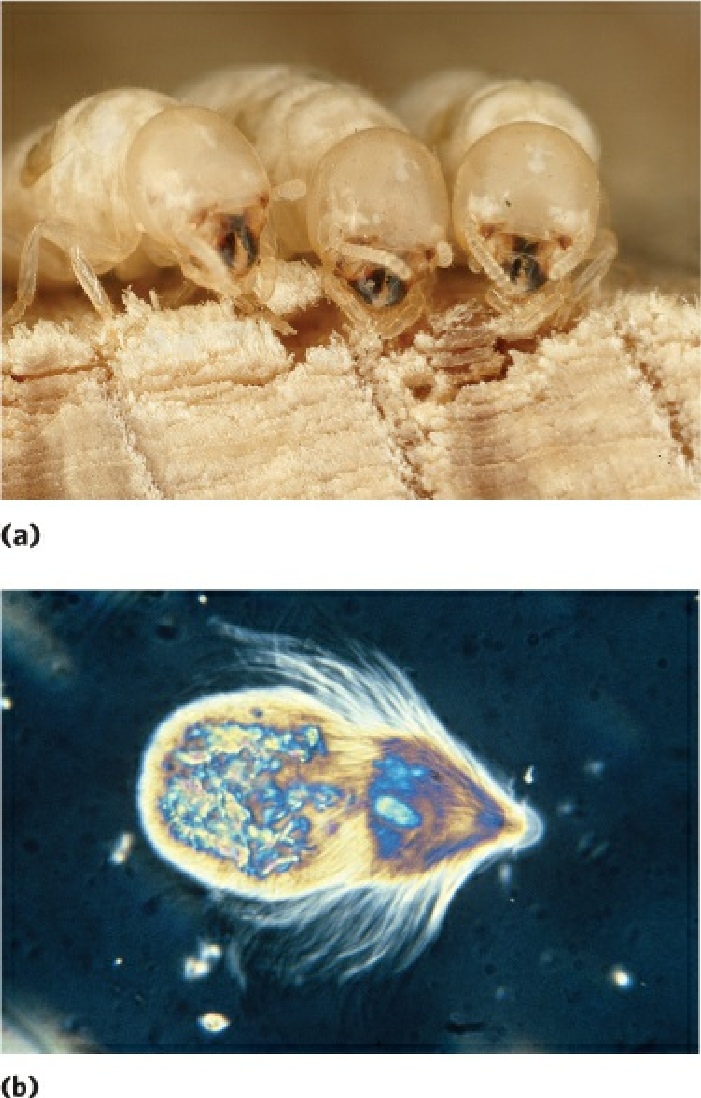
Termite
Trichonympha

Slide 41
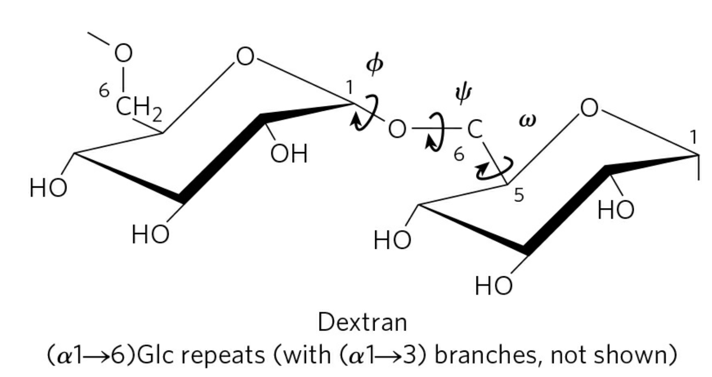
α-D-glucose as monomer

Slide 42
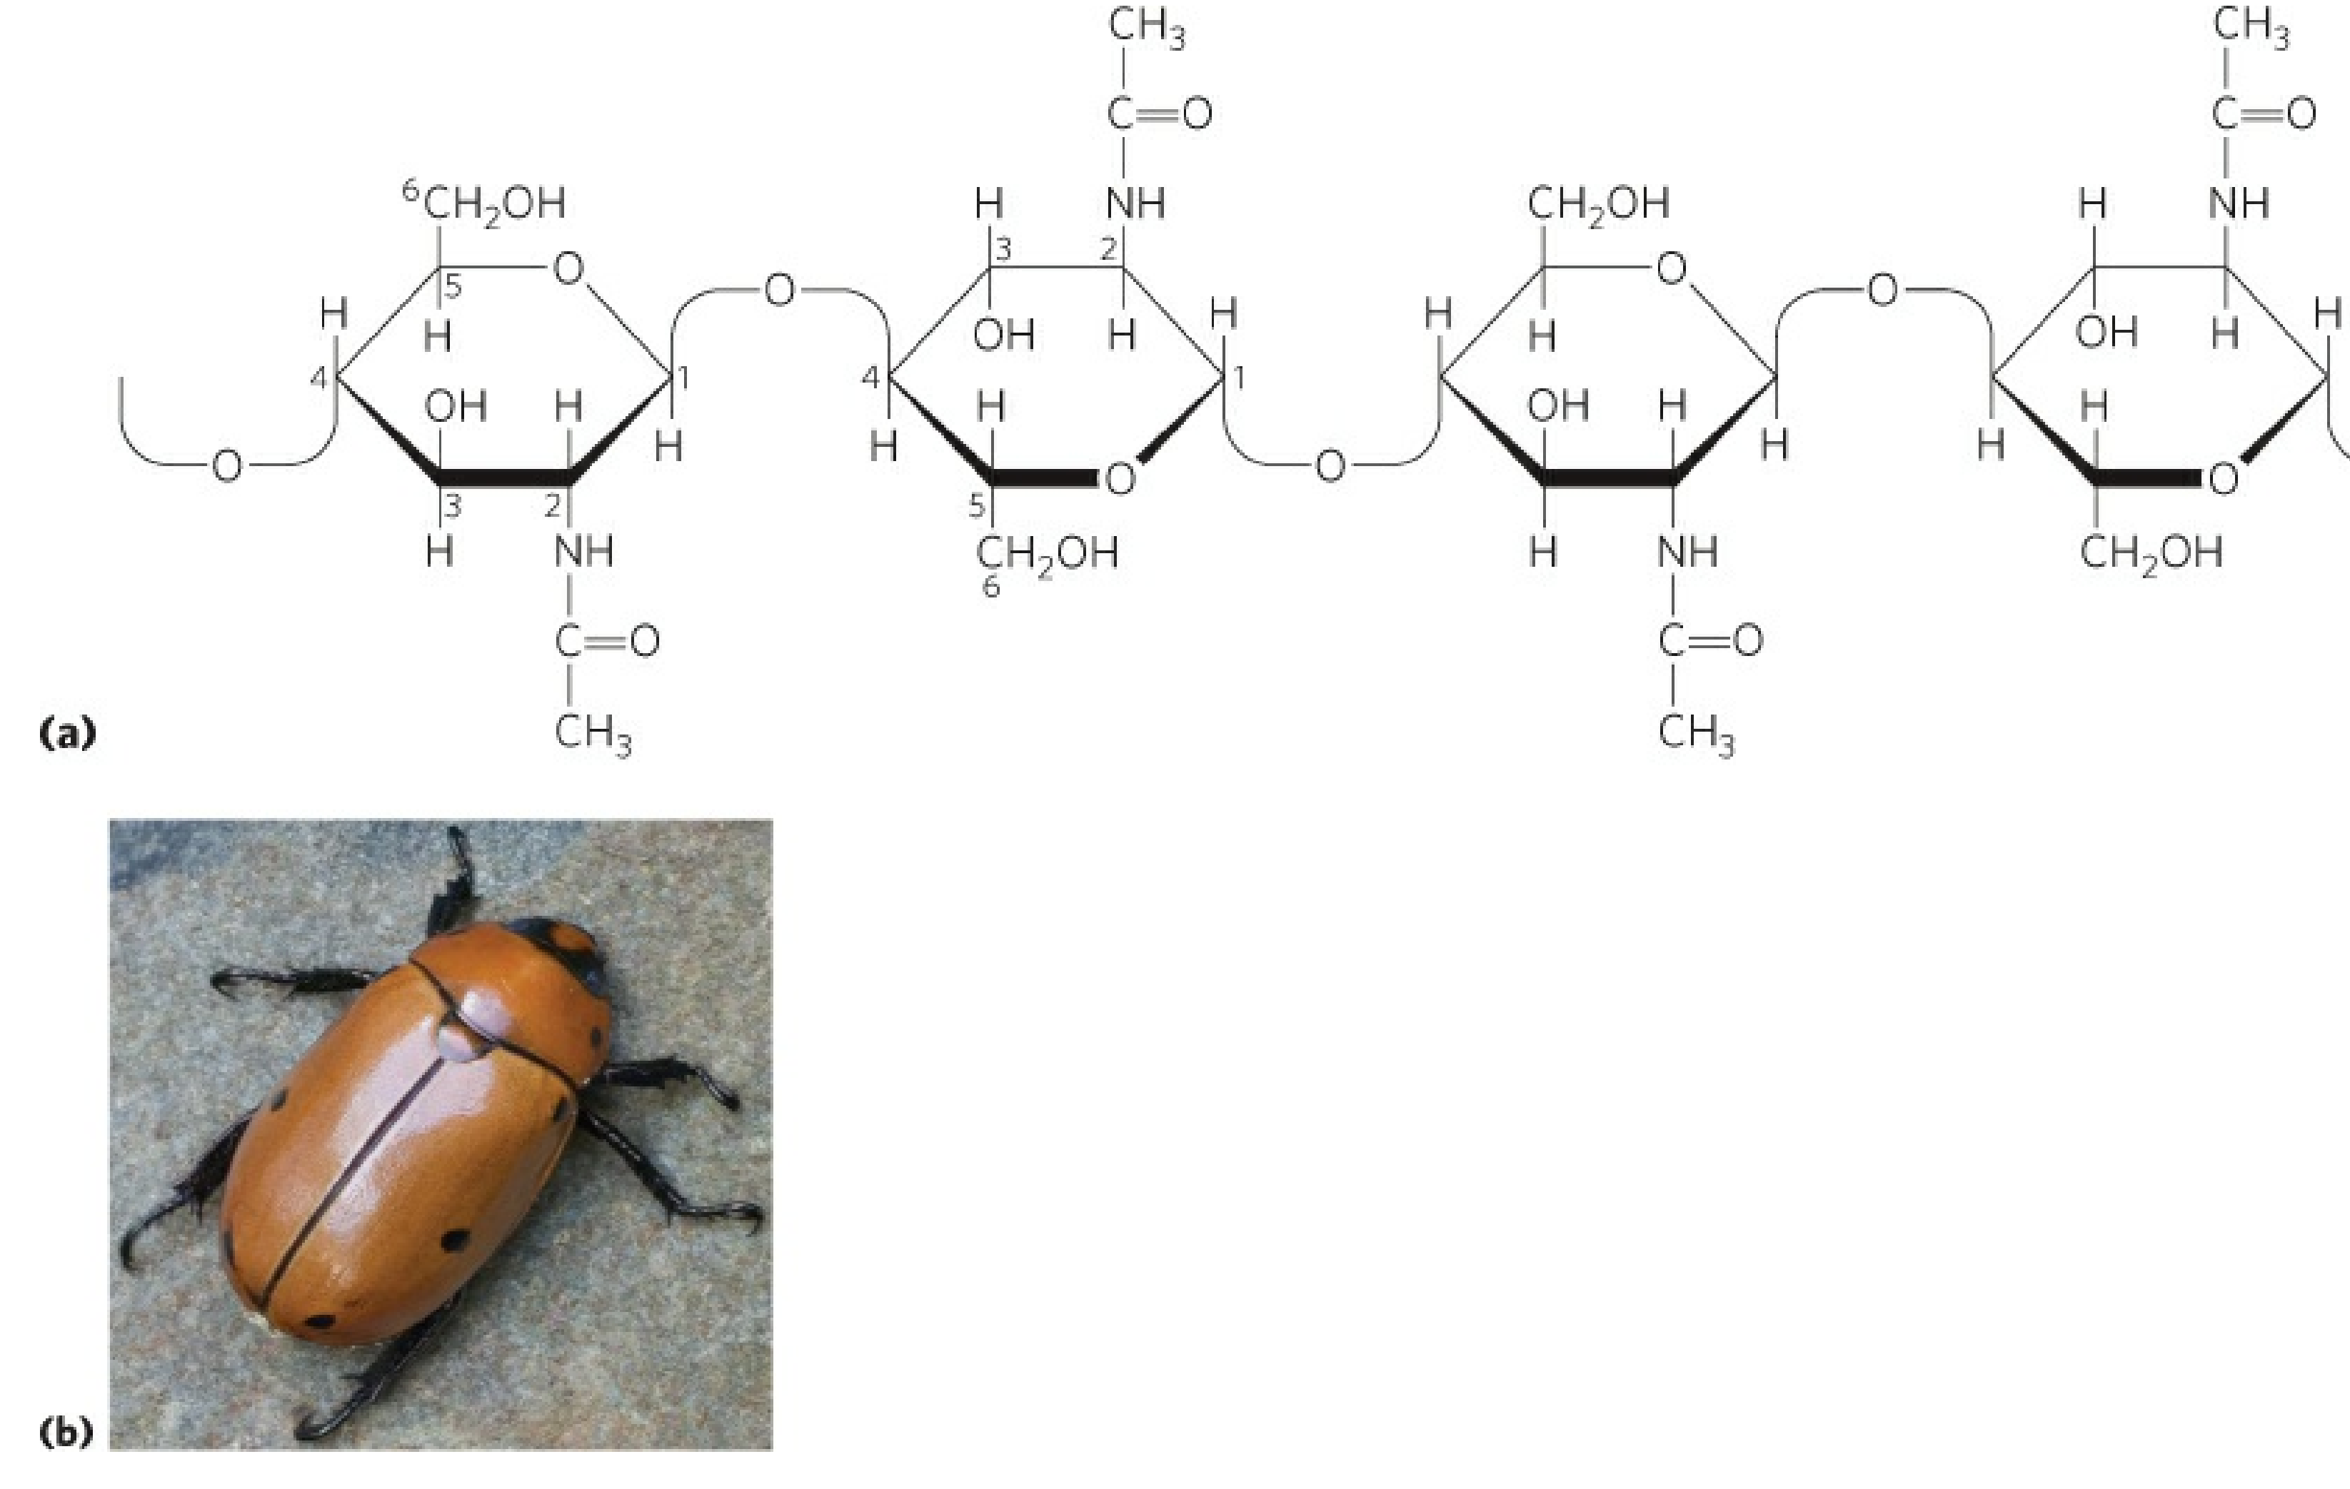
N-acetyl-D-glucosamine as monomer
β-D-glucose
Chitin
a homopolymer of N-acetyl-D-glucosamine units in (β1→4) linkage.

Slide 43
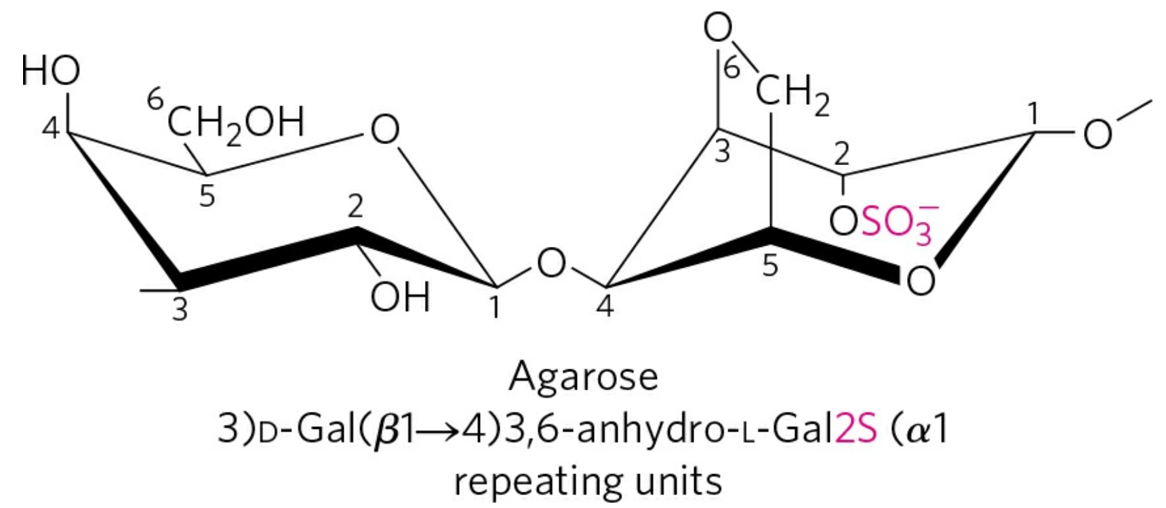
β-D-galactose， 3,6-andydro α -L-galactose， as monomer

Slide 44
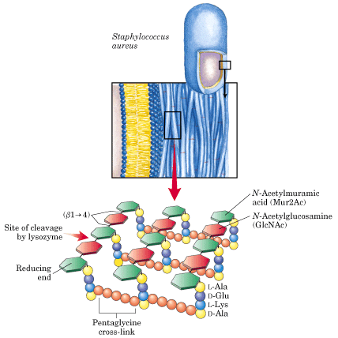
peptidoglycan

Slide 45
N—乙酰氨基葡萄糖 NAG

Slide 46
N—乙酰胞壁酸 NAM

Slide 47
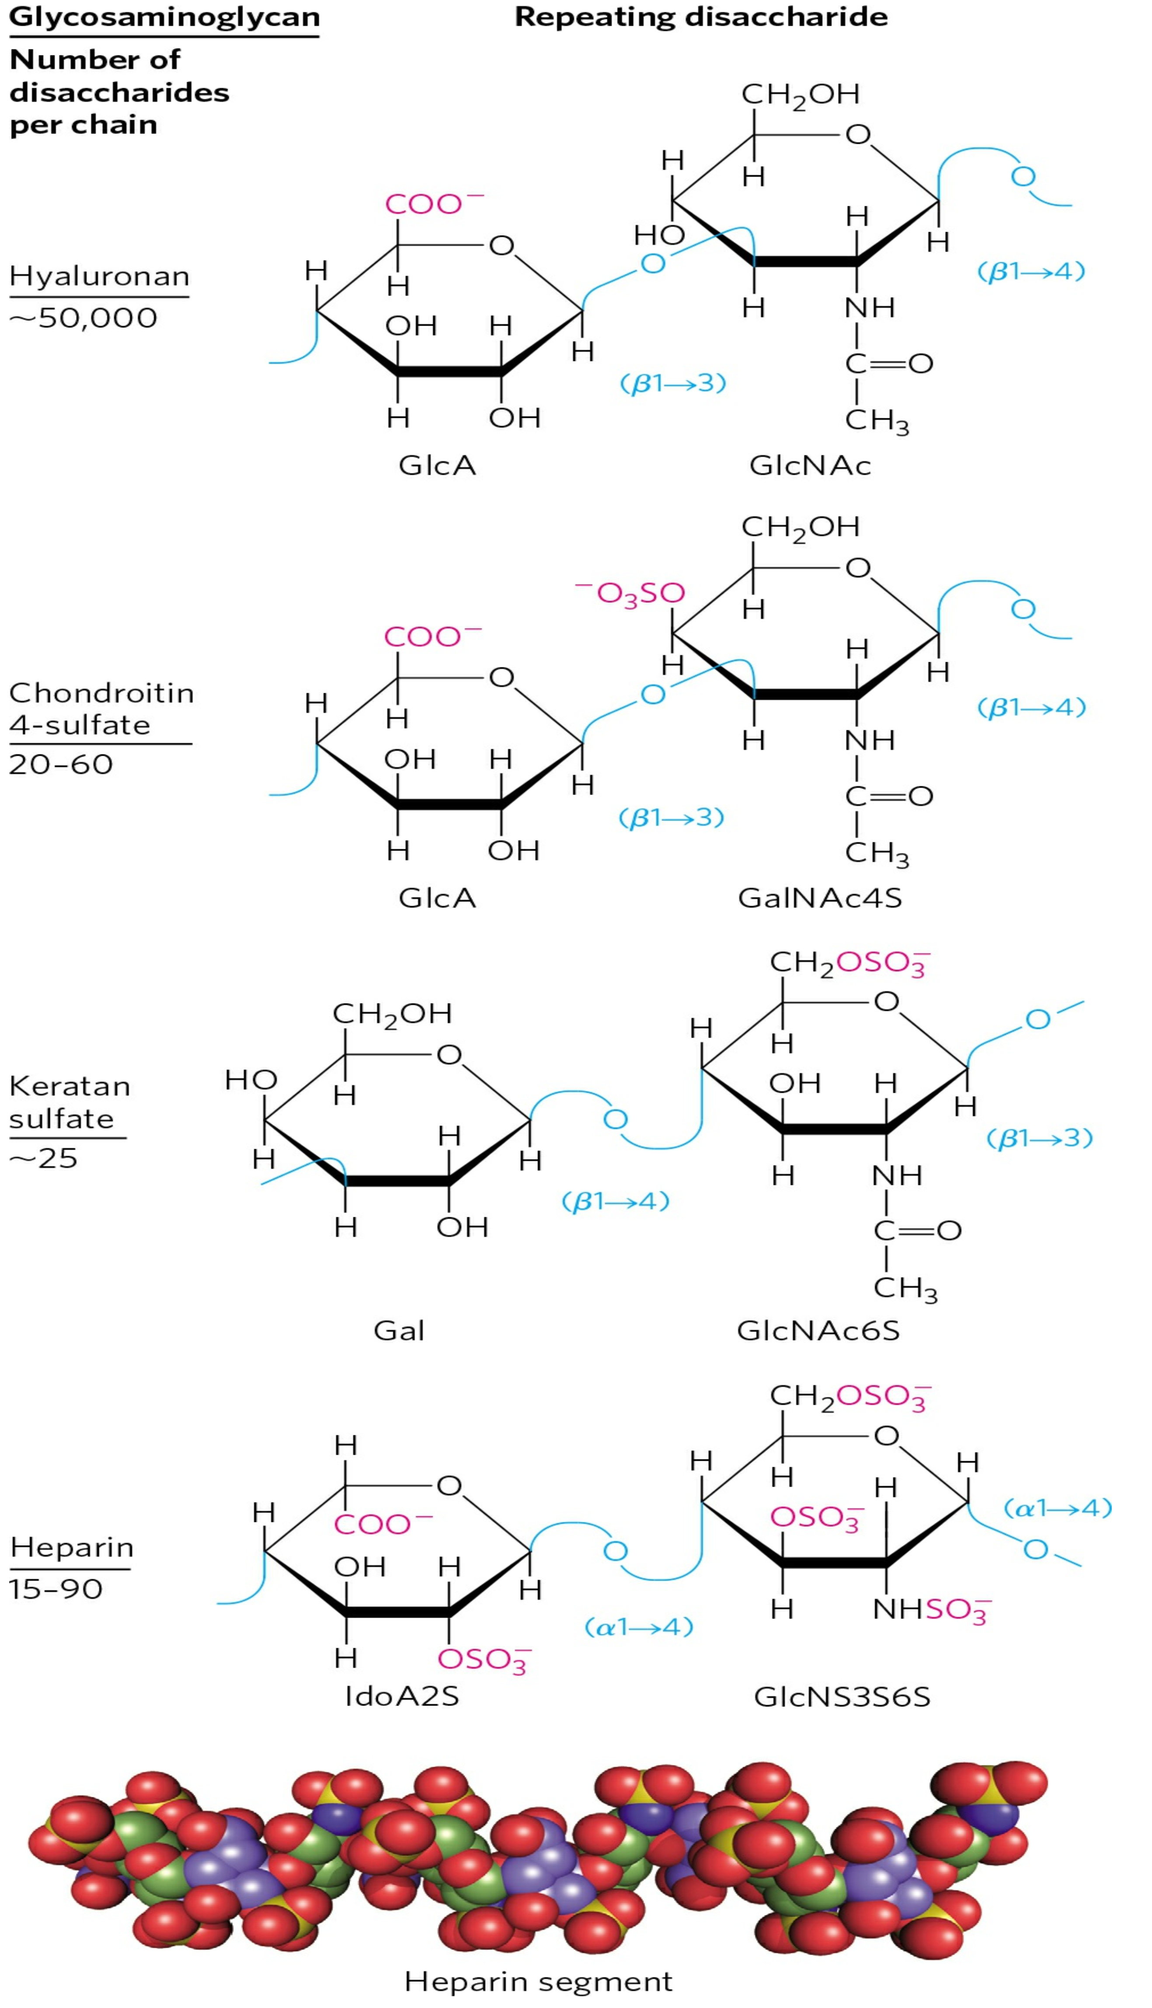

Slide 49
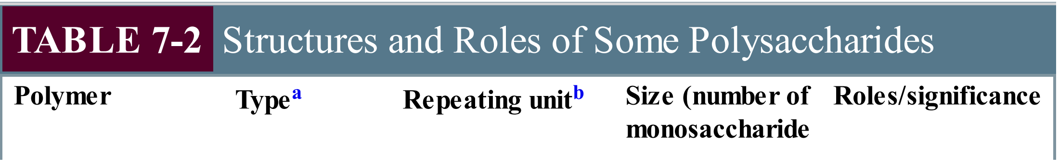
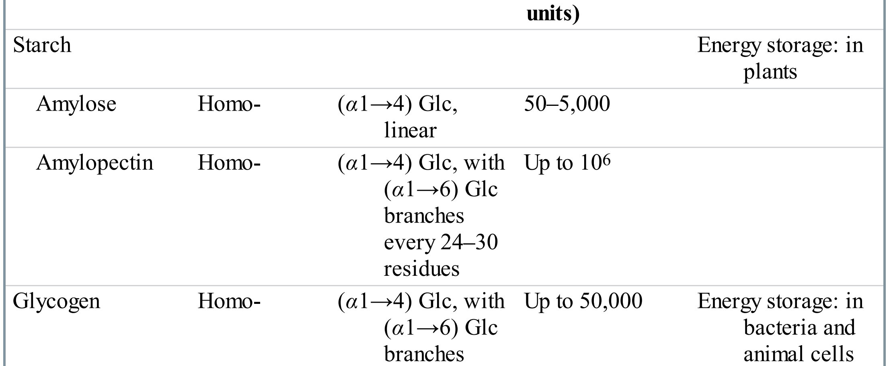
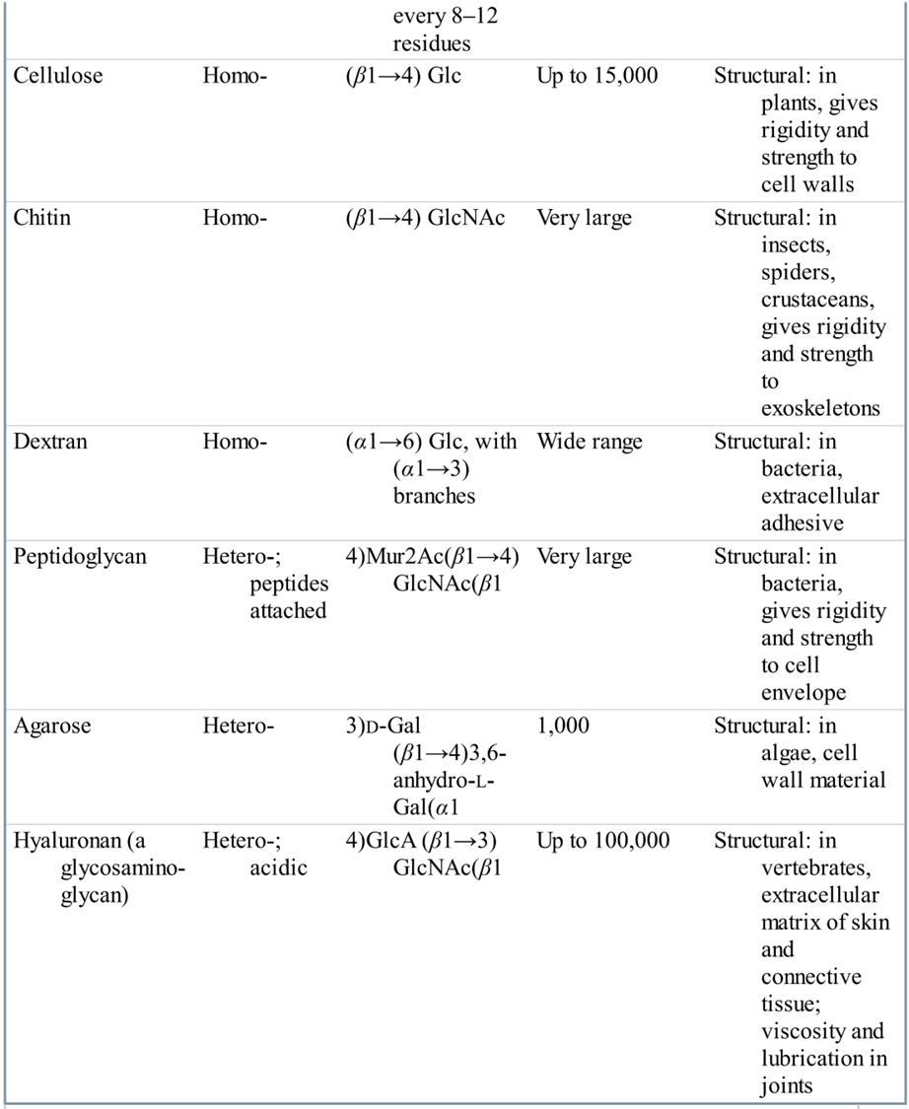

Slide 50


Slide 51
Carbohydrate metabolism
(Section J3---Glycolysis)
Glycolysis comes from the Greek glykys, meaning “sweet”, and lysis, meaning “splitting”.

Slide 52
1. The Development of Biochemistry and the Delineation of Glycolysis
1897, Eduard Buchner (Germany), accidental observation : sucrose was rapidly fermented into alcohol by cell-free yeast extract.
The accepted view that fermentation is tied to living cells was shaken and Biochemistry was born: Metabolism became chemistry!

Slide 53
1900s, Arthur Harden and William Young separated the yeast juice into two fractions: one heat-labile, nondialyzable enzymes and the other heat-stable, dialyzable cozymase (metal ions, ATP, ADP, NAD⁺).
1910s-1930s, Gustav Embden and Otto Meyerhof (Germany), studied muscle and its extracts:
  many reactions of lactic acid (muscle) and alcohol (yeast) fermentations were the same!
Glycolysis was also known as Embden-Meyerhof pathway and was elucidated by the 1940s.

Slide 54
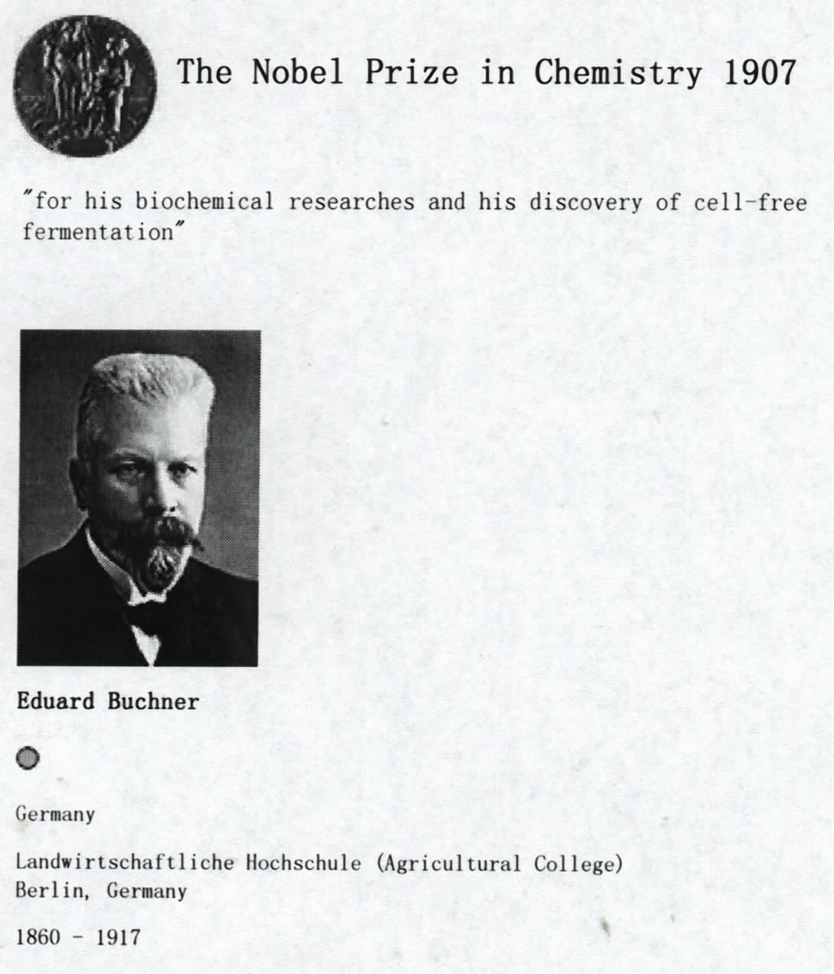

Slide 55
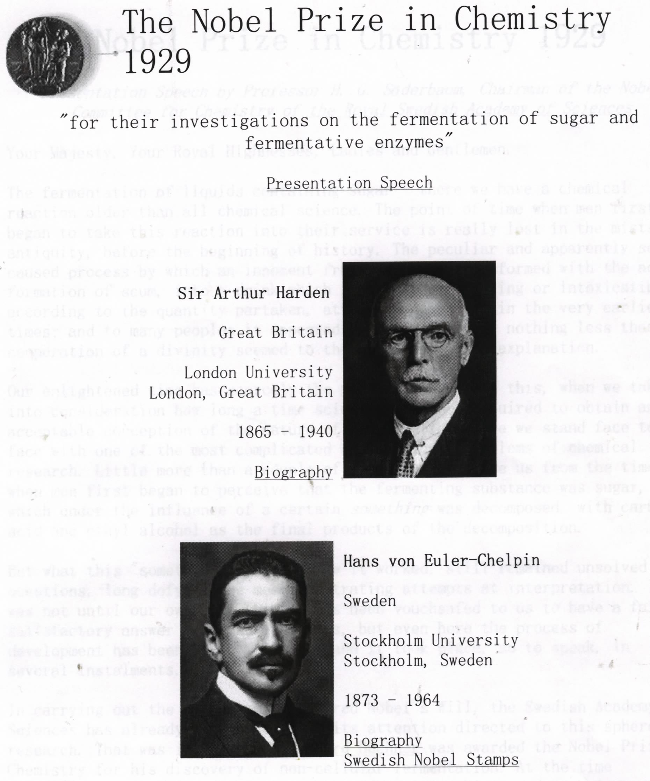

Slide 56
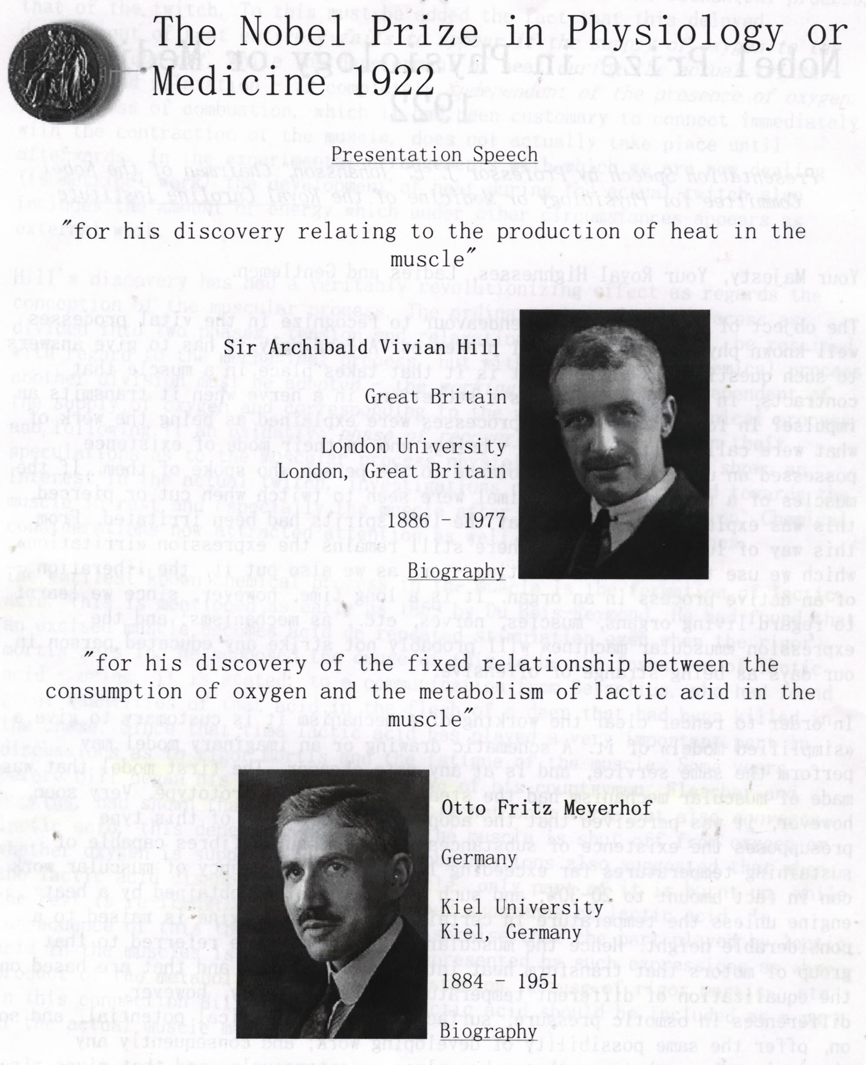

Slide 57
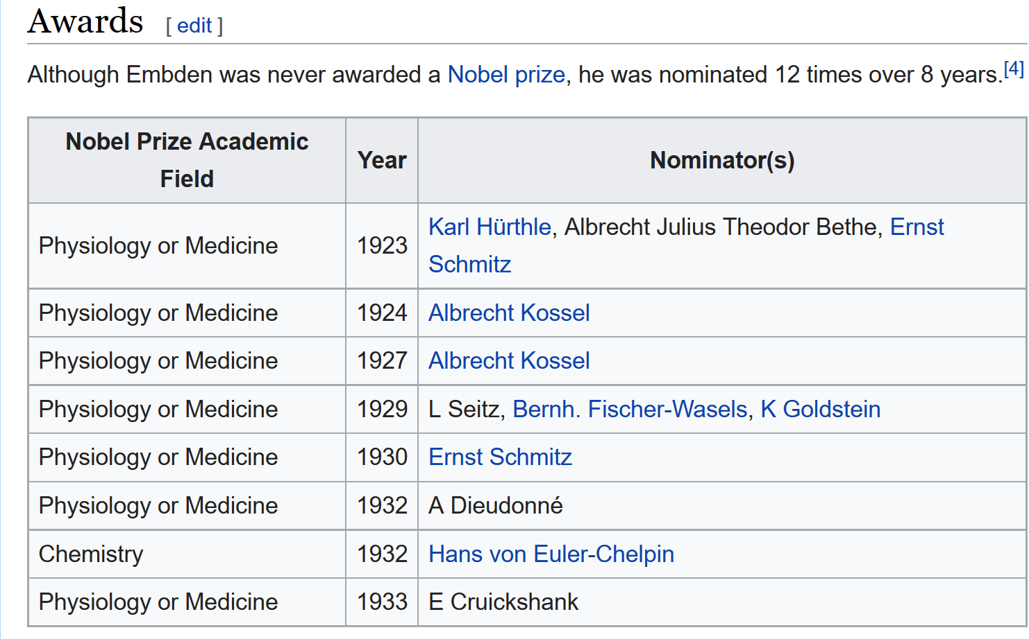
Gustav Embden

Slide 58


Slide 59

lactic acid

Slide 60
An overview on D-glucose metabolism
The major fuel of most organisms, ΔG'º = –2840 kJ/mole if completely oxidized to CO₂ and H₂O via the glycolysis pathway, citric acid cycle and oxidative phosphorylation (generating ATP) .
Can also be oxidized to make NADPH and ribose-5-P via the pentose phosphate pathway（PPP）.
Can be stored in polymer form (glycogen or starch) or be converted to fat for long term storage.
Is also a versatile precursor for carbon skeletons of almost all kinds of biomolecules, including amino acids, nucleotides, fatty acids, coenzymes and other metabolic intermediates.

Slide 61
2. The overall glycolysis can be divided into two phases
The hexose is first phossphorylated (thus activated) and then cleaved to produce two three-carbon intermediates at the preparatory phase, consuming ATP.
The three-carbon intermediates are then oxidized during the payoff phase, generating ATP and NADH.

Slide 62

Group
transfer
Isomerization
Group
transfer
cleavage
Isomerization

Slide 63

Dehydrogenation
Group
transfer
Group shift
Dehydration
PEP 磷酸烯醇式丙酮酸
Group
transfer

Slide 64



Slide 65
3. Ten enzymes catalyze the ten reactions of glycolysis
Hexokinase (also glucokinase in liver) catalyzes the first phosphorylation reaction on the pathway.
Phosphohexose isomerase (also called phosphoglucose isomerase) catalyzes the isomerization from glucose 6-P to fructose 6-P, converting an aldose to a ketose.

Slide 66


Irreversible
in cells
Glucose
Hexokinase
Induced
fit

Slide 67

An aldose
An ketose
Reversible

Slide 68
Phosphofructokinase-1 (PFK-1, 磷酸果糖激酶-1) then catalyzes the second phosphorylation step, converting fructose 6-P to fructose 1,6-bisphosphate; the overall rate of glycolysis is mainly controlled at this step; PFK-1 is a highly regulatory enzyme; the plant PFK-1 makes use of PP_{i}, instead of ATP at this step.

Slide 69


Slide 70
Aldolase (醛缩酶), named for the reverse reaction catalyzes the cleavage (“lysis”) of fructose 1,6-bisphosphate from the middle C-C bond to form two 3-carbon sugars, dihydroxyacetone phosphate and glyceraldehyde 3-phosphate; this is a reversal aldol condensation reaction.

Slide 71

A ketone
An aldehyde
1
4
2
5
✄
3
6
The “lysis” step

Slide 72


Slide 73
Triose phosphate isomerase converts dihydroacetone phosphate to glyceraldehyde 3-phosphate; an intramolecular redox reaction (a hydrogen atom is transferred from C-1 to C-2).

Slide 74

A ketose
An aldose

Slide 75
Glyceraldehyde 3-phosphate dehydrogenase catalyzes first the oxidation and then the phosphorylation of glyceraldehyde 3-P to form glycerate 1,3-bisphosphate, an acyl phosphate (酰基磷酸); the phosphate group linked to the carboxyl group via a anhydride bond has a high transfer potential.

Slide 76

acyl phosphate (酰基磷酸)

Slide 77
The phosphoglycerate kinase catalyzes the direct transfer of the anhydride phosphate in 1,3-BPG （glycerate 1,3-bisphosphate） to an ADP to generate an ATP; this is called the substrate-level phosphorylation; 1,3-BPG is a high energy intermediate that leads to ATP formation.

Slide 78

Substrate-level phosphorylation
For ATP generation
Enzyme is named for the reverse reaction

Slide 79

The phosphoglycerate mutase catalyzes the shift of phosphoryl group on 3-phosphoglycerate from C-3 to C-2.

Slide 80

Enolase (烯醇酶) catalyzes the elimination of a H₂O from 2-phosphoglycerate to generate phosphoenolpyruvate (PEP).

Slide 81
The pyruvate kinase (named for the reverse reaction) catalyzes the transfer of the phosphoryl group on PEP to ADP to form another molecule of ATP by “substrate-level phosphorylation”; enolpyruvate is formed and is quickly changed to pyruvate (丙酮酸).

Slide 82


Slide 83
Group
transfer
Hexokinase
Phosphohexose
isomerase
Isomerization
Group
transfer
Phosphofructokinase-1
cleavage
Aldolase
Triose phosphate
isomerase
Isomerization

Slide 84
Glyceraldehyde
3-phosphate
dehydrogenase
Dehydrogenation
phosphoglycerate
kinase
Group
transfer
phosphoglycerate mutase
Group shift
Dehydration
Enolase
pyruvate
kinase
Group
transfer

Slide 85
A net gain of two ATP, two NADH, two pyruvates are resulted when a glucose molecule is oxidized via the glycolysis pathway:
Glucose + 2 ADP + 2P_{i} + 2NAD⁺→
2 pyruvate + 2ATP + 2H₂O + 2NADH + 2H⁺

Slide 86
4. Fermentation: pyruvate is converted to lactic acid or ethanol under anaerobic conditions
This occurs to regenerate NAD⁺ for the glycolysis pathway to continue when O₂ lacks.

Slide 87
sheath
sheath

Slide 88
Lactic acid fermentation (occurring in very active muscle, some bacteria): pyruvate is reduced by NADH, catalyzed by lactate dehydrogenase.
The lactate produced in muscle can be converted back to glucose by gluconeogenesis in the liver of vertebrates.

Slide 89

Pyruvate is reduced
to lactate when O₂
lacks in a reaction
catalyzed by lactate
Dehydrogenase.

Slide 90
Ethanol fermentation (occurring in yeast and other microorganisms): pyruvate is first decarboxylated and then reduced by NADH, catalyzed by pyruvate decarboxylase and alcohol dehydrogenase respectively.

Slide 91

Pyruvate can be
decarboxylated
and reduced to
form ethanol
in some micro-
organisms

Slide 92
5. Energy yield
Two ATP are used in glycolysis and four ATPs are synthesized for each molecule of glucose so that the net yield is two ATPs per glucose.
Under aerobic conditions, the two NADH molecules arising from glycolysis also yield energy via oxidative phosphorylation.

Slide 93
6. Other hexoses are also oxidized via the glycolysis pathway
They are also first primed by phosphorylation (at C-1 or C-6).
Fructose is primed and cleaved to form dihydroxyacetone phosphate and glyceraldehyde, which are further converted to glyceraldehyde 3-P.
Galactose is first converted to Glc-1-P via a UDP-galactose intermediate and UDP-glucose intermediate, then to Glc-6-P.

Slide 94

One fructose is converted to
two glyceraldehyde 3-P

Slide 95


Slide 96
6. Regulation of glycolysis
Phosphofructokinase-1 (PFK-1) is the main point of regulation for controlling the rate of glycolysis. PFK is allosterically inhibited by ATP, but this inhibition is relieved by AMP. Citrate also inhibits PFK. The build up of F-6-P stimulates the formation of 2,6-FBP that in turn stimulates PFK.
Hexokinase and pyruvate kinase are additional control sites.

Slide 97
Summary
D-glucose is a commonly used fuel and versatile precursor in almost all organisms.
Glucose is first converted into two three-carbon pyruvates via the ten-step glycolysis pathway without directly consuming O₂ and with a net production of two ATP molecules by substrate-level phosphorylation.
Limited amount of energy can be released by oxidizing glucose under anaerobic conditions by fermentation.

Slide 99


Slide 100


Slide 101
The Citric Acid Cycle (L1)
The common pathway leading to complete oxidation of carbohydrates, fatty acids, and amino acids to CO₂.
A pathway providing many precursors for biosynthesis

Slide 102


Slide 104


Slide 105
1. The cellular respiration can be divided into three stages
Stage I All the fuel molecules are oxidized to generate a common two-carbon unit, acetyl-CoA.
Stage II The acetyl-CoA is completely oxidized into CO₂, with electrons collected by NAD and FAD via a cyclic pathway (named as the citric acid cycle, Krebs cycle, or tricarboxylic acid cycle（TCA）).
Stage III Electrons of NADH and FADH₂ are transferred to O₂ via a series carriers, producing H₂O and a H⁺ gradient, which will promote ATP formation.

Slide 106


Slide 107


Slide 108


Slide 109


Slide 110

Stage I

Slide 111

Stage II

Slide 112

Stage III

Slide 113


Slide 114

Mitochondria is the major site for
fuel oxidation to generate ATP.

Slide 115
2. Pyruvate is oxidized to acetyl-CoA by the catalysis of pyruvate dehydrogenase complex
Pyruvate is first transported into mitochondria via a specific transporter on the inner membrane.
Pyruvate is converted to acetyl-CoA and CO₂ by oxidative decarboxylation.

Slide 116

The oxidative decarboxylation of pyruvate
in mitochondria: producing acetyl-CoA and CO₂.

Slide 117
The pyruvate dehydrogenase complex is a huge multimeric assembly of three kinds of enzymes, having 60 subunits in bacteria and more in mammals.
pyruvate dehydrogenase (E₁)
dihydrolipoyl transacetylase (E₂)
dihydrolipoyl dehydrogenase (E₃)

Slide 118
丙酮酸脱氢酶复合体
E1: 丙酮酸脱氢酶组分（ pyruvate dehydrogenase ）
E2：二氢硫辛酸转乙酰基酶
（ dihydrolipoyl transacetylase ）
E3：二氢硫辛酸脱氢酶
（ dihydrolipoyl dehydrogenase ）
辅因子：CoA-SH, NADH,硫辛酸
FAD，TPP，
Mg ^{2＋}

Slide 119



Slide 120


Slide 121

The oxidative decarboxylation of pyruvate is catalyzed by
a multienzyme complex: pyruvate dehydrogenase complex.

Slide 122

thiamine pyrophosphate (TPP)
焦磷酸硫胺素
Confusing with
base T Thymine

Slide 123

Lipoic acid (lipoate) in amide linkage with a Lys residue.
硫辛酸

Slide 124

Coenzyme A (CoA-SH): discovered in 1945 by
Lipmann, one of the “carrier molecules”,
deliver activated acyl groups (with 2-24
Carbons) for degradation or biosynthesis.

Slide 125
3. The complete oxidation of pyruvate in animal tissues was proposed to undergo via a cyclic pathway
Hans Krebs proposed the “citric acid cycle” for the complete oxidation of pyruvate in animal tissues in 1937 (he wrongly hypothesized that pyruvate condenses with oxaloacetate in his original proposal).
The citric acid cycle was confirmed to be universal in cells by in vitro studies with purified enzymes and in vivo studies with radio isotopes (“radio isotope tracer experiments”).
Krebs was awarded the Nobel prize in medicine in 1953 for revealing the citric acid cycle (thus also called the Krebs cycle).

Slide 126


Slide 127
4. The acetyl group (carried by CoA) is completely oxidized to CO₂ via the citric acid cycle
The 4-carbon oxaloacetate (草酰乙酸) acts as the “carrier” for the oxidation.
The two carbons released as 2 CO₂ in the first cycle of oxidation are not from the acetyl-CoA just joined.
The 8 electrons released are collected by three NAD⁺ and one FAD.
One molecule of ATP (or GTP) is produced per cycle by substrate-level phosphorylation.

Slide 128


Slide 129

The citric
acid cycle

Slide 130
5. The citric acid cycle consists
of eight successive reactions
Step 1
Citrate (6C) is formed from the irreversible condensation of acetyl CoA (2C) and oxaloacetate (4C) – catalyzed by citrate synthase.

Slide 131


Slide 132


Slide 133
Step 2 Citrate is isomerized into isocitrate via a dehydration step followed by a hydration step; cis-aconitate (顺乌头酸) is an intermediate during this transformation, thus the catalytic enzyme is named as aconitase.

Slide 134


Slide 135


Slide 136
Step 3 Isocitrate is first oxidized and then decarboxylated to form a-ketoglutarate (α-酮戊二酸); two electrons are collected by NAD⁺; The reaction is catalyzed by isocitrate dehydrogenase.

Slide 137


Slide 138

The first
oxidation step
Isocitrate is converted to α-ketoglutarate via an
oxidative decarboxylation step, generating NADH
CO₂.

Slide 139
Step 4 α-ketoglutarate undergoes another round of oxidative decarboxylation; decarboxylated first, then oxidized to form succinyl-CoA (琥珀酰辅酶A); The reaction is catalyzed by α-ketoglutarate dehydrogenase complex; reactions and enzymes closely resemble pyruvate dehydrogenase complex (with similar E₁ and E₂, identical E₃).

Slide 140

Step 4

Slide 141

TPP lipoate
FAD
(E₁, E₂, E₃)
The second
oxidation step
The α-ketoglutarate dehydrogenase complex
closely resembles the pyruvate dehyrogenase
complex in structure and function.

Slide 142
Step 5 Succinyl-CoA is hydrolyzed to succinate (琥珀酸); the free energy is harvested by a GDP or an ADP to form a GTP or an ATP by substrate-level phosphorylation.

Slide 143


Slide 144


Slide 145
Step 6 Succinate is oxidized to fumarate (延胡索酸或反丁烯二酸); catalyzed by a flavoprotein succinate dehydrogenase (with a covalently bound FAD); malonate (丙二酸) is a strong competitive inhibitor of the enzyme, that will block the whole cycle.

Slide 146


Slide 147

The third oxidation step

Slide 148

From Section C Enzyme
Inhibition of succinate dehydrogenase by malonate

Slide 149
Step 7 Fumarate is hydrated to L-malate by the action of fumarase; the enzyme is highly stereospecific, only act on the trans and L isomers, not on the cis and D isomers .

Slide 150

L-malate
Trans-fumarate

Slide 151

Trans-fumarate

Slide 152
Step 8 Oxaloacetate is regenerated by the oxidation of L-malate; this reaction is catalyzed by malate dehydrogenase with two electrons collected by NAD⁺.

Slide 153


Slide 154

(The fourth oxidation
Step in the cycle)
Oxaloacetate is regenerated at the end

Slide 156
6. The complete oxidation of one glucose may yield as many as 32 ATP
All the NADH and FADH₂ will eventually pass their electrons to O₂ after being transferred through a series of electron carriers.
The complete oxidation of each NADH molecule leads to the generation of 2.5 ATP, and FADH₂ of about 1.5 ATP.

Slide 157


Slide 158


Slide 159
7. The citric acid intermediates are important sources for biosynthetic precursors
The citric acid cycle is the hub of intermediary metabolism serving both the catabolic and anabolic processes.
It provides precursors for the biosynthesis of glucose, amino acids, nucleotides, fatty acids, sterols, heme groups, etc.

Slide 161
回补反应： 当中间产物用于其它物质的合成，须补充OAA，以使循环继续

Slide 162
8. Net conversion of acetate to carbohydrates is allowed via the glyoxylate cycle (乙醛酸循环）
Net conversion of acetate to four-carbon citric acid cycle intermediates occurs via the glyoxylate cycle, found in plants, certain invertebrates, and some microorganisms (including E. coli and yeast).
The glyoxylate cycle shares three steps and bypasses the rest, including the two decarboxylation steps, of the citric acid cycle.

Slide 163
Two acetyl-CoA molecules enter each glyoxylate cycle with a net production of one succinate.
Isocitrate lyase and malate synthase are the two bypassing enzymes, converting isocitrate to malate via the glyoxylate intermediate, releasing a succinate on the way.

Slide 164
The glyoxylate
cycle

Slide 165
Conversion of stored fatty acids to sucrose
in germinating seeds through the glyoxylate cycle
Peroxisome

Slide 168
9. The pyruvate dehydrogenase complex in vertebrates is regulated alloseterically and covalently
10. The rate of the citric acid cycle is controlled at three exergonic irreversible steps

Slide 170
Citrate synthase, isocitrate dehydrogenase and α-ketoglutarate dehydrogenase;
Inhibited by product feedback (citrate, succinyl-CoA) and high energy charge (ATP, NADH);
Activated by a low energy charge (ADP) or a signal for energy requirement (Ca²⁺).

Slide 171
Summary
Pyruvate is converted to acetyl-CoA by the action of pyruvate dehydrogenase complex, a huge enzyme complex.
Acetyl-CoA is converted to 2 CO₂ via the eight-step citric acid cycle, generating three NADH, one FADH₂, and one ATP (by substrate-level phophorylation).
Intermediates of citric acid cycle are drawn off to synthesize many other biomolecules, including fatty acids, steroids, amino acids, heme, pyrimidines, and glucose.

Slide 172
The activity of pyruvate dehydrogenase complex is regulated by allosteric effectors and reversible phosphorylations.
Net conversion of fatty acids to glucose can occur in germinating seeds, some invertebrates and some bacteria via the glycoxylate cycle, which shares three steps with the citric acid cycle but bypasses the two decarboxylation steps, converting two molecules of acetyl-CoA to one succinate.
Acetyl-CoA is partitioned into the glyoxylate cycle and citric acid cycle via a coordinately regulation of the isocitrate dehydrogenase and isocitrate lyase.

Slide 173
J5 Pentose phosphate pathway
(戊糖磷酸途径)
Overview
Main reactions of the pathway
Control of the pathway

Slide 174
Pentose phosphate pathway converts glucose to specialized products needed by the cells
Glc-6-P is first dehydrogenated by a NADP⁺-containing dehydrogenase to form 6-phosphogluconate (6-磷酸葡萄糖酸).
6-phosphogluconate then undergoes a oxidative decarboxylation to form D-ribulose 5-P, generating another molecule of NADPH.
D-ribulose 5-P is then converted to ribose 5-P.

Slide 175
When NADPH is the primary requirement in the cell, the pentose phosphates are recycled into Glc-6-P via a series of rearrangements of the carbon skeleton, catalyzed by transketolase and transaldolase (no cofactor involved).
Six five-carbon sugar phosphates are converted to five six-carbon sugar phosphates.
The reverse of this rearrangement, regeneration of six five-carbon sugar phosphate from five six-carbon sugar phosphate occurs in the Calvin cycle (for photosynthetic fixation of CO₂ in plants).

Slide 176
Stage 1 Oxidative reactions

Slide 177
①
③
②
④
FIGURE Oxidative reactions of the pentose phosphate pathway.
The end products are ribose 5-phosphate, CO2, and NADPH.

Slide 178

Stage 2: The regeneration of six-carbon Glucose 6-P from five-carbon Ribose 5-P

Slide 179


Slide 181

核酮糖 5-磷酸
木酮糖 5-磷酸
Ribulose 5-P is first isomerized to form
xylulose 5-P to initiate the regeneration
of glucose 6-P.

Slide 182

（转酮醇酶）
Acceptor
(aldose)
7-磷酸景天庚酮糖
Donor
(ketose)

Slide 183

（转醛醇酶）
景天庚酮糖
赤藓糖

Slide 184

（转酮醇酶）

Slide 186
PPP途径的非氧化分子重排阶段（stage2）
阶段一：异构化
阶段二：转酮醇、转醛醇
阶段三：异构化形成6磷酸葡萄糖
阶段一
6 5-磷酸核酮糖
异构酶
2
2 5-磷酸木酮糖
5-磷酸核糖
转酮醇酶，2C
阶段二
2 3-磷酸甘油醛
2 7-磷酸景天庚酮糖
转醛醇酶, 3C
2 6-磷酸果糖
2 4-磷酸赤藓丁糖
2 5-磷酸木酮糖
转酮醇酶， 2C
阶段三
5 6-磷酸葡萄糖
2 6-磷酸果糖
2 3-磷酸甘油醛
醛缩酶
6-磷酸果糖
1, 6-二磷酸果糖
Pi
H₂O

Slide 187


Counter the damaging effects of oxygen radicals

Slide 188
Gluconeogenesis
(J4)
Gluconeogenesis: The universal pathway for synthesis of glucose.

Slide 189


Slide 190
1. Carbohydrates are synthesized from simple precursors via gluconeogenesis
A few three-carbon compounds (including lactate, pyruvate, glycerol, and 3-phosphoglycerate) serve as the major precursors for carbohydrate (glucose) biosynthesis, or gluconeogenesis.
The reactions of gluconeogenesis are essentially the same in different organisms.
The conversion of pyruvate to glucose is the central pathway in gluconeogenesis.

Slide 191
2. The opposing pathways of glycolysis and gluconeogenesis have 3 reactions different and 7 reactions in common
The reversible reactions between pyruvate and glucose are shared by gluconeogenesis and glycolysis, but the irreversible reactions are different (“bypassed” in gluconeogenesis).

Slide 192


Slide 193
3. Pyruvate is converted to phosphoenoylpyruvate (PEP) via two Exergonic Reactions

Slide 194


Slide 196


Slide 197

4. Conversion of fructose 1,6-bisphosphate to fructose 6-phosphate is the second bypassing step
The reaction is catalyzed by Mg ²⁺ -dependent fructose 1,6-bisphosphatase (instead of phosphofructokiase-1).

Slide 198
5. The conversion of glucose 6-phosphate to glucose is the last bypassing step
The reaction is catalyzed by glucose 6-phosphatase (instead of hexokiase).

Slide 202
6. More energy is consumed in gluconeogenesis than produced in glycolysis
Six high-energy phosphate groups are required when two molecules of pyruvates are converted to one glucose via gluconeogenesis pathway.
Two molecules of ATP are produced when one glucose molecule is converted to two pyruvate molecules via glycolysis pathway.

Slide 203
Summary
Gluconeogenesis, the synthesis of glucose from 3-carbon compounds (mainly pyruvate) is highly conserved in all organisms.
Gluconeogenesis shares most of the reactions occurring in glycolysis, but bypassing the three irreversible reactions (using different enzymes).
Gluconeogenesis consumes more energy than glycolysis releases.

Slide 204
J 6 Polysaccharide
Metabolism
（catabolism, anabolism）
Glycogen Starch Sucrose

Slide 205
1. Glycogen in cells is first converted to Glc-1-P for oxidative degradation
The glucose unit at the nonreducing terminal of glycogen is removed as Glc-1-P via phosphorolysis: The (α1 4) glycosidic bond is attacked by an inorganic phosphate).

Slide 206

No ATP
Consumed!

Slide 208

Glycogen breakdown near an (α1→6) branch point.
a bifunctional
debranching enzyme

Slide 209
2. Dietary poly- and disaccharides are hydrolyzed to monosaccharides in the digestive system
Salivary α-amylase (α-淀粉酶) in the mouth hydrolyzes starch (glycogen) into short polysaccharides or oligosacchrides.
Specific enzymes (e.g., lactase, sucrase, maltase,etc.) finally hydrolyze all disaccharides into monosaccharides.

Slide 210
3. Biosynthesis of glycogen, starch, and sucrose
Hexoses are converted to sugar nucleotides before being polymerized
Hexose nucleotides are common precursors for carbohydrate transformation and polymerization!
A hexose nucleotides is formed via a condensation reaction occurring between a NTP and a hexose 1-phosphate.

Slide 211

Sugar nucleotides were found to be the activated forms of sugars participating in biosynthesis.

Slide 212
Glucose-1-P

Slide 213
A sugar nucleotide is formed through a
condensation reaction between a NTP
and a sugar phosphate.
Glucose-1-P + UTP UDP-glucose + PPi

Slide 215
Glycogen is synthesized using UDP-glucose
The glucose residue of UDP-Glucose is transferred to the nonreducing end of a primer or glycogen branch (of at least 4 glucose residues) to make a new a-1,4 glycosidic bond in a reaction catalyzed by glycogen synthase.

Slide 216
primer

Slide 217
The formation of (a1→6) branches of glycogen is catalyzed by glycosyl-(4→6)-transferase: a terminal fragment of 6-7 residues is transferred from a branch having at least 11 residues to the C-6 hydroxyl group at a more interior position of the same or another glycogen chain.

Slide 218
11<
6-7
A branching enzyme catalyzes the
transferring of a short stretch of Glc
residues from one nonreducing end
to the interior of the glycogen to make
an α1→6 linkage (thus a branch).

Slide 220
Starch synthesis in chloroplast stroma is similar to glycogen synthesis
But ADP-glucose is used as the precursor.
Starch synthase also transfers the glucose unit to the nonreducing end of a preexisting primer (form amylose 直链淀粉)
Branches in amylopectin (支链淀粉) are synthesized using a similar branching enzyme.

Slide 221
primer

Slide 222
Sucrose is synthesized from UDP-glucose and fructose 6-phosphate in the cytosol of plant cells
Sucrose 6-phosphate is first synthesized by the catalysis of sucrose 6-phosphate synthase.
The phosphate is then removed in a reaction catalyzed by sucrose 6-phosphate phosphatase.

Slide 223
Sucrose is
synthesized
from UDP-Glc
and Fru 6-P

Slide 224
Carbohydrates can be synthesized from CO₂ in photosynthetic organisms

Slide 226
The three stages of CO2 assimilation in photosynthetic organisms

Slide 227

Second stage of CO₂ assimilation.

Slide 228

Third stage
of CO₂ assimilation

Slide 229


Slide 231
END
Thank you

Slide 232


Slide 233

Integration of photosystems I and II in chloroplasts

Slide 234
Proton and electron circuits during photophosphorylation.

Slide 235
Orientation of ATP synthase is fixed relative to the proton gradient

Slide 236
Light activation of several enzymes of the Calvin cycle

Slide 237
Carbon assimilation in
C4 plants.

Slide 238
Photorespiration Results from Rubisco’s Oxygenase Activity
Rubisco is not absolutely specific for CO₂ as a substrate. Molecular oxygen (O₂) competes with CO₂ at the active site, and about once in every three or four turnovers, rubisco catalyzes the condensation of O₂ with ribulose 1,5-bisphosphate to form 3-phosphoglycerate and 2-phosphoglycolate (Fig. 20- 47), a metabolically useless product.

Slide 239
Glycolate pathway

